Slide 1
EE5907/EE5027 Week 3: Univariate Gaussian + Naive Bayes
BT Thomas Yeo
ECE, CSC, CIRC, N.1, HMS

Slide 2
Last Week Recap
Probabilistic Signal Detection / Estimation
MAP & ML estimation
Notes:
Last week, we talk about probabilistic signal detection or estimation, which is a key goal in statistical machine learning
I show you MAP and maximum likelihood estimation.
MAP estimation corresponds to finding the mode of the posterior distribution. Maximum likelihood is a special case of MAP estimation where the prior is uniformly distributed.

Slide 3
Last Week Recap
Probabilistic Signal Detection / Estimation
MAP & ML estimation
Two approaches of modeling posterior distribution: Generative & Discriminative Models
Notes:
Much of statistical machine learning is about how to model the posterior distribution. There are two ways to do this: generative modeling or discriminative modeling

Slide 4
Last Week Recap
Probabilistic Signal Detection / Estimation
MAP & ML estimation
Two approaches of modeling posterior distribution: Generative & Discriminative Models
Parameters of probabilistic models can themselves be treated as random variables and estimated accordingly
Notes:
Once we have settled on a model, we need to learn the parameters of the model.
It turns out that the parameters of the probabilistic models can themselves be treated as random variables and be estimated accordingly.

Slide 5
Last Week Recap
Probabilistic Signal Detection / Estimation
MAP & ML estimation
Two approaches of modeling posterior distribution: Generative & Discriminative Models
Parameters of probabilistic models can themselves be treated as random variables and estimated accordingly
Conjugate priors
Beta-Binomial generative model (binomial parameters are beta distributed)
Dirichlet-Multinomial generative models (multinomial parameters are dirichlet distributed)
Notes:
I then show you how the parameters of probabilistic models can be estimated for different specific examples.
In particular, I show you the beta-binomial generative model where we assume a beta prior on the parameters of the binomial distribution.
And I show you the Dirichlet-Multinomial model, where we assume a dirichlet prior on the parameters of the multinomial distribution.
The priors we utilize are conjugate in the sense that the posterior distributions belong to the same family as the prior distribution.

Slide 6
Last Week Recap
Probabilistic Signal Detection / Estimation
MAP & ML estimation
Two approaches of modeling posterior distribution: Generative & Discriminative Models
Parameters of probabilistic models can themselves be treated as random variables and estimated accordingly
Conjugate priors
Beta-Binomial generative model (binomial parameters are beta distributed)
Dirichlet-Multinomial generative models (multinomial parameters are dirichlet distributed)
Predicting future coin toss / dice rolls
Posterior predictive distribution, Plug-In Approximation, Black Swan
Notes:
Once we have observed some coin tosses or dice rolls, we can try to predict future coin toss or dice rolls based on existing data.
This is called the posterior predictive distribution.
We can approximate the posterior predictive distribution using Maximum Likelihood or MAP estimates of the model parameters. This is called plug-in approximation. If we have a lot of data, then this is ok. But if we don’t have enough data, then we will overfit resulting in black swan events.

Slide 7
This Week
Last week, binomial and multinomial are discrete random variables,
This week, look at continuous example: univariate Gaussian
Then we will then combine what we have learned last lecture and this lecture to study our first generative classifier: naives Bayes
Notes:
The binomial and multinomial distributions are discrete. Today, let’s look at a continuous distribution, which is Gaussian.
After that, we will look at our first generative classifier: naive Bayes

Slide 8
Questions?
Notes:
Any questions before I continue?

Slide 9
Univariate Gaussian

Slide 10
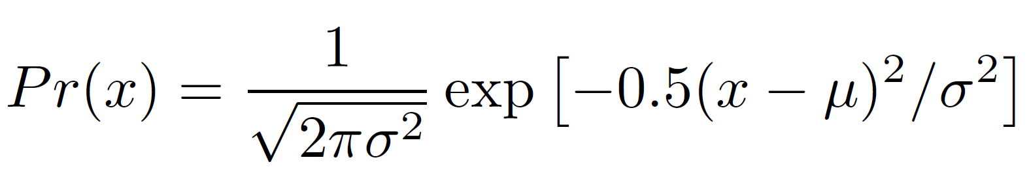
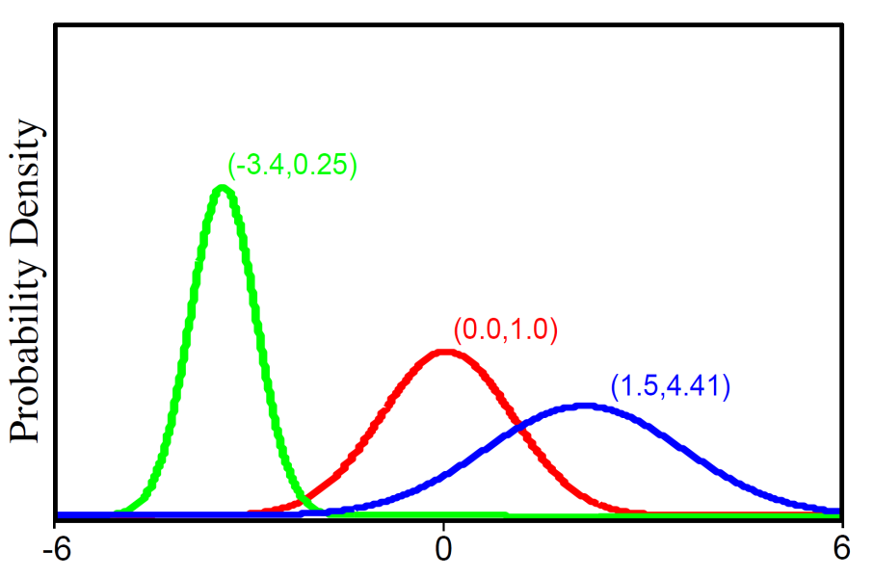
Univariate Gaussian Distribution
For short we write:
Univariate normal distribution describes single continuous variable.
Takes 2 parameters μ and σ²>0
Notes:
So as a reminder, here’s the univariate gaussian distribution, parameterized by the mean mu and the variance sigma square.
p of x is equal to 1 over square root 2pi sigma square <POINT> times e to the negative <POINT> 0.5 TIMES x minus mu square <POINT> divided by sigma square.
The mean controls the position of the gaussian distribution. As we increase the mean, the distribution is translated to the right. As we decrease the mean, the distribution is translated to the left.
The variance controls the width of the distribution. As we increase the variance, the distribution becomes wider. As we decrease the variance, the distribution becomes narrower.

Slide 11
ML estimation of μ, σ² given training data D = {x₁,…,x_{N}}
Notes:
Suppose we observe N i.i.d samples of a Gaussian distribution, x1 to xN.
Let’s perform ML estimation of the mean and variance.
According to the ML criteria, we want to find the values of mu and sigma square that maximizes the likelihood p of x1 to xN given mu and sigma square.

Slide 12
ML estimation of μ, σ² given training data D = {x₁,…,x_{N}}
conditional independence
Notes:
The first trick is to recognize that given mean and variance, x1 to xN are conditionally independent. This is like the coin example right? Suppose we know the true biasness of the coin, the coin tosses are independent. Similarly, suppose we know the true mean and variance of the gaussian distribution, the samples are independent.
This means that p of x1 to xN given mu and sigma square is equal to p of x1 given mu and sigma square TIMES p of x2 given mu and sigma square TIMES p of x3 given mu and sigma square and so on.

Slide 13
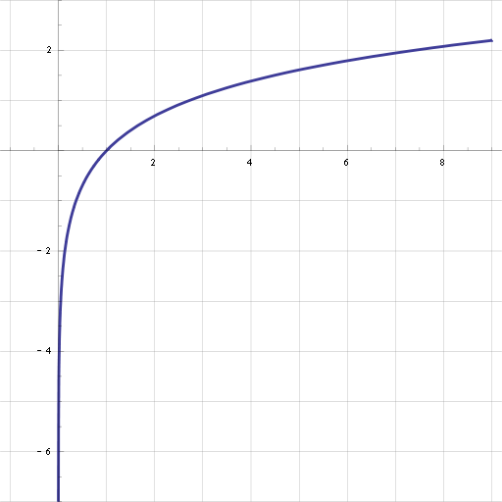
ML estimation of μ, σ² given training data D = {x₁,…,x_{N}}
conditional independence
y = log x
Because log is monotonic
Notes:
The next trick is to apply the logarithm to the probability.
We can do this because log is a monotonic function. Log is always increasing.
So if we apply log to this term, the objective function will change BUT the value of mu and sigma square maximizing the objective function will stay the same.

Slide 14
ML estimation of μ, σ² given training data D = {x₁,…,x_{N}}
conditional independence
y = log x
Because log is monotonic
Notes:
The reason why we want to apply the log is because we want to convert the product into sum.
Log has this nice property that the log (AB) is equal to (log A) PLUS (log B).
So in this case, we get sum from n = 1 to N. LOG p(x n | mu, sigma square)

Slide 15
ML estimation of μ, σ² given training data D = {x₁,…,x_{N}}
conditional independence
y = log x
Because log is monotonic
Notes:
Now we will plug in the Gaussian formula.
When we apply log to 1 over square root 2 pi sigma square, we get minus log square root 2 pi sigma square
When we apply log to e to the negative (xn – mu) square divided by 2 sigma square, the log cancels out the exponential and we are left with minus (xn – mu) square divided by 2 sigma square.

Slide 16
ML estimation of μ, σ² given training data D = {x₁,…,x_{N}}
Notes:
Ok, so from the previous slide, so far we want to find mu and sigma that maximizes this function sum from n = 1 to N MINUS xn – mu square over 2 sigma square MINUS log sqrt of 2pi sigma square.

Slide 17
ML estimation of μ, σ² given training data D = {x₁,…,x_{N}}
Notes:
Our strategy is to differentiate this whole function with respect to mu and set to 0.
The second term does not contain mu, so we only need to care about the first term when differentiating with respect to mu.
So we have to differentiate sum from n = 1 to N MINUS xn minus mu square divided 2 sigma2

Slide 18
ML estimation of μ, σ² given training data D = {x₁,…,x_{N}}
Notes:
And so we get this. Everyone ok?
We bring down power of 2, which cancels with the denominator. The power of 2 becomes 1, and we multiply by -1 because we differentiate xn minus mu.

Slide 19
ML estimation of μ, σ² given training data D = {x₁,…,x_{N}}
Notes:
So we set this to 0.
We bring sigma square over to the right hand side, and so sigma square is gone.

Slide 20
ML estimation of μ, σ² given training data D = {x₁,…,x_{N}}
Notes:
And so by rearranging the terms, we get mu hat is equal to 1 over N sum of all the samples xn.
So the ML estimate of mu is the empirical mean.

Slide 21
ML estimation of μ, σ² given training data D = {x₁,…,x_{N}}
Notes:
Similarly, we can differentiate with respect to sigma square and set to 0. I will not walk you through the details of the differentiation since this is basic calculus.
But if we do the differentiation and set to 0, we find that the ML estimate of sigma square is equal to the empirical variance of the dataset:
1 over N sum from n = 1 to N (xn minus mu hat) square. Where mu hat is the ML estimate of the mean.

Slide 22
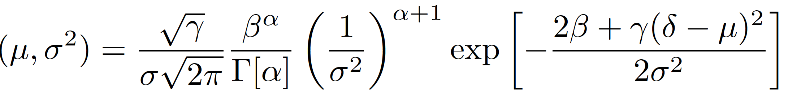
Modeling μ, σ² as random variables using Normal Inverse Gamma Distribution
Defined on 2 variables μ and σ²>0
or for short
Four parameters α > 0, β > 0, γ > 0 and δ.
Notes:
Now let’s model the mean and variance as random variables.
In particular, a nice conjugate distribution for the gaussian is the normal inverse gamma distribution parameterized by alpha, beta, gamma, delta.
Alpha, beta and gamma are all greater than 0, while delta can take any value.
The probability distribution of mu and sigma square is given by this rather complex looking formula.

Slide 23
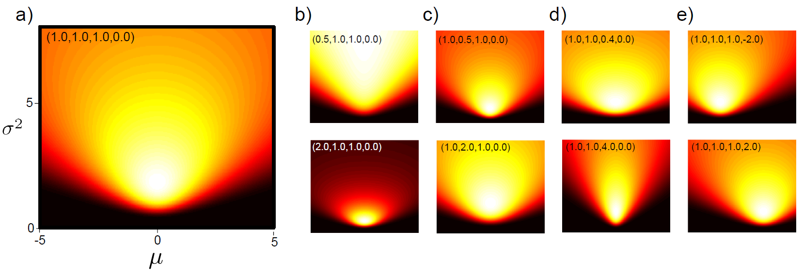
Modeling μ, σ² as random variables using Normal Inverse Gamma Distribution
Defined on 2 variables μ and σ²>0
or for short
Four parameters α > 0, β > 0, γ > 0 and δ.
(α, β, γ, δ) = (1, 1, 1, 0)
σ²
μ
Notes:
We can visualize the distribution as follows. This is the distribution when alpha, beta and gamma are equal to 1 and delta is equal to 0.
x-axis corresponds to mu, y-axis corresponds to variance.
Notice that mu can go from –infinity to infinity, while sigma square is strictly greater than 0.
Since delta is 0, notice that the distribution is centered at mu = 0.

Slide 24
Modeling μ, σ² as random variables using Normal Inverse Gamma Distribution
Defined on 2 variables μ and σ²>0
or for short
Four parameters α > 0, β > 0, γ > 0 and δ.
(α, β, γ, δ) = (1, 1, 1, 0)
(1, 1, 1, -2.0)
σ²
σ²
μ
Notes:
If we keep all the parameters the same, but change delta to be -2, the distribution shifts to being centered at mu = -2.

Slide 25
Modeling μ, σ² as random variables using Normal Inverse Gamma Distribution
Defined on 2 variables μ and σ²>0
or for short
Four parameters α > 0, β > 0, γ > 0 and δ.
(α, β, γ, δ) = (1, 1, 1, 0)
(1, 1, 1, -2.0)
σ²
σ²
(1, 1, 1, +2.0)
σ²
μ
μ
Notes:
If we keep all the parameters the same, but change delta to be +2, the distribution shifts to being centered at mu = +2.

Slide 26
Modeling μ, σ² as random variables using Normal Inverse Gamma Distribution
Defined on 2 variables μ and σ²>0
or for short
Four parameters α > 0, β > 0, γ > 0 and δ.
(α, β, γ, δ) = (1, 1, 1, 0)
(1, 1, 0.4, 0)
(1, 1, 1, -2.0)
σ²
σ²
(1, 1, 4.0, 0)
(1, 1, 1, +2.0)
σ²
μ
μ
μ
Notes:
Gamma controls the concentration of mu.
If we decrease gamma from 1 to 0.4, notice that the distribution becomes wider in the x-direction, so it’s easier for mu to be far from 0.

Slide 27
Modeling μ, σ² as random variables using Normal Inverse Gamma Distribution
Defined on 2 variables μ and σ²>0
or for short
Four parameters α > 0, β > 0, γ > 0 and δ.
(α, β, γ, δ) = (1, 1, 1, 0)
(1, 1, 0.4, 0)
(1, 1, 1, -2.0)
σ²
σ²
(1, 1, 4.0, 0)
(1, 1, 1, +2.0)
σ²
μ
μ
μ
Notes:
If we increase gamma from 1 to 4, notice that the distribution becomes narrower in the x-direction, so it’s easier for mu to be far from 0.

Slide 28
Modeling μ, σ² as random variables using Normal Inverse Gamma Distribution
Defined on 2 variables μ and σ²>0
or for short
Four parameters α > 0, β > 0, γ > 0 and δ.
(α, β, γ, δ) = (1, 1, 1, 0)
(0.5, 1, 1, 0)
(1, 0.5, 1, 0)
(1, 1, 0.4, 0)
(1, 1, 1, -2.0)
σ²
σ²
(2.0, 1, 1, 0)
(1, 2.0, 1, 0)
(1, 1, 4.0, 0)
(1, 1, 1, +2.0)
σ²
μ
μ
μ
μ
μ
Notes:
Both alpha and beta controls the variance sigma square.
If we decrease alpha from 1 to 0.5 or we increase beta from 1 to 2
Then on average, the distribution will shift upwards in the y-direction and the distribution will also become broader in the y-direction.

Slide 29
Modeling μ, σ² as random variables using Normal Inverse Gamma Distribution
Defined on 2 variables μ and σ²>0
or for short
Four parameters α > 0, β > 0, γ > 0 and δ.
(α, β, γ, δ) = (1, 1, 1, 0)
(0.5, 1, 1, 0)
(1, 0.5, 1, 0)
(1, 1, 0.4, 0)
(1, 1, 1, -2.0)
σ²
σ²
(2.0, 1, 1, 0)
(1, 2.0, 1, 0)
(1, 1, 4.0, 0)
(1, 1, 1, +2.0)
σ²
μ
μ
μ
μ
μ
Notes:
Conversely, if we increase alpha from 1 to 2 or we decrease beta from 1 to 0.5
Then on average, the distribution will shift towards 0 in the y-direction and the distribution will also become narrower in the y-direction.

Slide 30
MAP estimation of μ, σ² given training data D = {x₁,…,x_{N}}
Notes:
So let’s perform MAP estimation of mu and sigma given i.i.d samples x1 to xN.
By definition, we want to find mu and sigma that maximizes the posterior probability of mu and sigma square given x1 to xN.

Slide 31
MAP estimation of μ, σ² given training data D = {x₁,…,x_{N}}
Bayes’ rule
Notes:
The first trick is to apply Bayes rule.
This corresponds to the numerator of Bayes’ rule: prior of mu and sigma square TIMES the likelihood p of x1 to xN given mu and sigma2.
The denominator from Bayes’ rule does not depend on mu and sigma square, so it’s a constant factor, which we can throw away

Slide 32
MAP estimation of μ, σ² given training data D = {x₁,…,x_{N}}
Bayes’ rule
conditional independence
Notes:
The next trick is conditional independence like in the case of ML estimation.
So p of x1 to xN given mu and sigma square is equal to p of x1 given mu and sigma square TIMES p of x2 given mu and sigma square and so on.

Slide 33
MAP estimation of μ, σ² given training data D = {x₁,…,x_{N}}
Bayes’ rule
conditional independence
Because log is monotonic
Notes:
Again we apply log to the equation.
Notice how we are using the same set of tricks as ML estimation?

Slide 34
MAP estimation of μ, σ² given training data D = {x₁,…,x_{N}}
Bayes’ rule
conditional independence
Because log is monotonic
Notes:
And we can convert the product into sum using the property that log of a TIMES b is equal to log a + log b.
So we have log of the prior probability of mu and sigma square + sum from n = 1 to N log of the likelihood of xn GIVEN mu and sigma square.

Slide 35
MAP estimation of μ, σ² given training data D = {x₁,…,x_{N}}
Bayes’ rule
conditional independence
Because log is monotonic
Notes:
Now let’s plug in the formula for the normal inverse gamma distribution and the gaussian distribution.
I have thrown away the normalization constant of the normal inverse gamma distribution because it is not a function of mu or sigma, so it’s a constant which we can throw away here.

Slide 36
MAP estimation of μ, σ² given training data D = {x₁,…,x_{N}}
Notes:
So from the previous slide, we want mu and sigma that maximizes this complicated looking function.
The first two terms log of 1 over sigma TIMES 1 over sigma square to the power of alpha + MINUS 2 beta + gamma TIMES delta minus mu square divided by 2 sigma square comes from the prior distribution.
The last two terms comes from the gaussian likelihood, which we have seen previously in ML estimation.

Slide 37
MAP estimation of μ, σ² given training data D = {x₁,…,x_{N}}
Notes:
Like before, to maximize with respect to mu, we can differentiate and set to 0.
And if we do that, we find the MAP estimate of mu is sum of xn from n = 1 to capital N PLUS gamma TIMES delta DIVIDED by N + gamma.
The sum of xn is of course equal to N times the maximum likelihood of mu. So we see that the MAP estimate of mu is tradeoff between the ML estimate and the prior mean delta.
This is just like in the case of the beta-binomial and dirichlet multinomial distributions we studied last week. When there is a lot of data, N is big, so data overwhelms the prior and the MAP estimate is close to the ML estimate. When there is very little data, then the prior plays a big role in the estimate.
Remember gamma is the parameter that controls the concentration of the prior mean. When gamma is small, then we are imposing a weak prior on the mean of the Gaussian distribution. And therefore, the MAP estimate will be close to the ML estimate.

Slide 38
MAP estimation of μ, σ² given training data D = {x₁,…,x_{N}}
Notes:
Similarly, we can differentiate with respect to sigma, set it to 0 and we get the following MAP estimate of sigma, where mu hat is the MAP estimate of mu.

Slide 39
MAP estimation of μ, σ² given training data D = {x₁,…,x_{N}}
Notes:
Again, notice that if N is big, then mu hat is close to the empirical mean, and the first term is close to N TIMES the empirical variance.
And so like before, if N is big, the estimate of variance is close to the empirical variance.

Slide 40
MAP estimation of μ, σ² given training data D = {x₁,…,x_{N}}
*see uploaded
Detailed derivations*
*see uploaded
Detailed derivations*
Notes:
I have also uploaded detailed derivations of these formulas.
But before you look at the derivations, you should try to go back and perform the differentiation and verify for yourself it’s true.

Slide 41
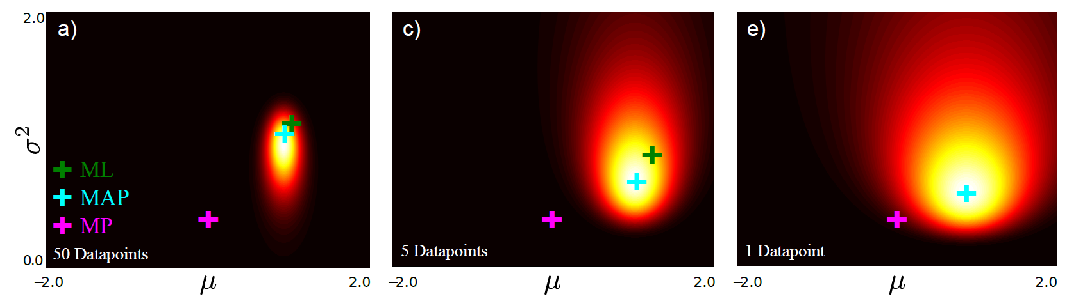
Fitting normal distribution: MAP
50 data points
5 data points
1 data points
Notes:
Here’s a visualization of the posterior probability as we go from 1 data point to 50 data points. X axis is the mean, and y-axis is the variance. The heatmap corresponds to the posterior distribution.
The purple + corresponds to the prior mean and variance. Notice the prior is the same across all 3 plots, so the purple + is in the same location.
The green + corresponds to the ML estimate of the mean and variance. Notice that there is no green cross with 1 data point because the ML estimate of variance is not defined when there is only 1 datapoint.
The blue + corresponds to the MAP estimate. In general we see that the blue + is between the green and green pluses, because MAP trades off between prior and the data likelihood.
We also see that the posterior probability is more diffuse when we only have 1 datapoint. But by the time we have 50 datapoints, the posterior distribution is a lot more focal and concentrated.

Slide 42
Predicting Future Gaussian Samples
Notes:
Now suppose we have observed N Gaussian samples, so we have training data D, consisting of x1, x2 to xN
Let x* be the next Gaussian sample. What is the pdf of x*

Slide 43
Predicting Future Gaussian Samples
Notes:
The first strategy is to simply estimate the pdf of x* to be a Gaussian with mean and variance equal to the maximum likelihood estimates from the previous slides.

Slide 44
Predicting Future Gaussian Samples
Notes:
The second strategy is to simply estimate the pdf of x* to be a Gaussian with mean and variance equal to the MAP estimates from the previous slides.

Slide 45
Predicting Future Gaussian Samples
Notes:
The problem with the maximum likelihood and MAP strategies is that they are not exactly optimal.
In the above problem, the question is ”Suppose we are given D, what is the pdf of x*”
So we actually want to evaluate p(x* | D), but this is actually NOT even Gaussian.
How do we compute this pdf?

Slide 46
Posterior Predictive Distribution
Procedure same as dirichlet-multinomial and beta-bernoulli, but a bit tedious. Please refer to murphy-2007.pdf, which I will upload
Notes:
Remember that in the posterior predictive estimation, we want to compute the probability of observing a new sample x* given the current observations x1 to xN.
The procedure is the same as before, so here I just provide you with the formulas. I will upload detailed derivations from Kevin Murphy.

Slide 47
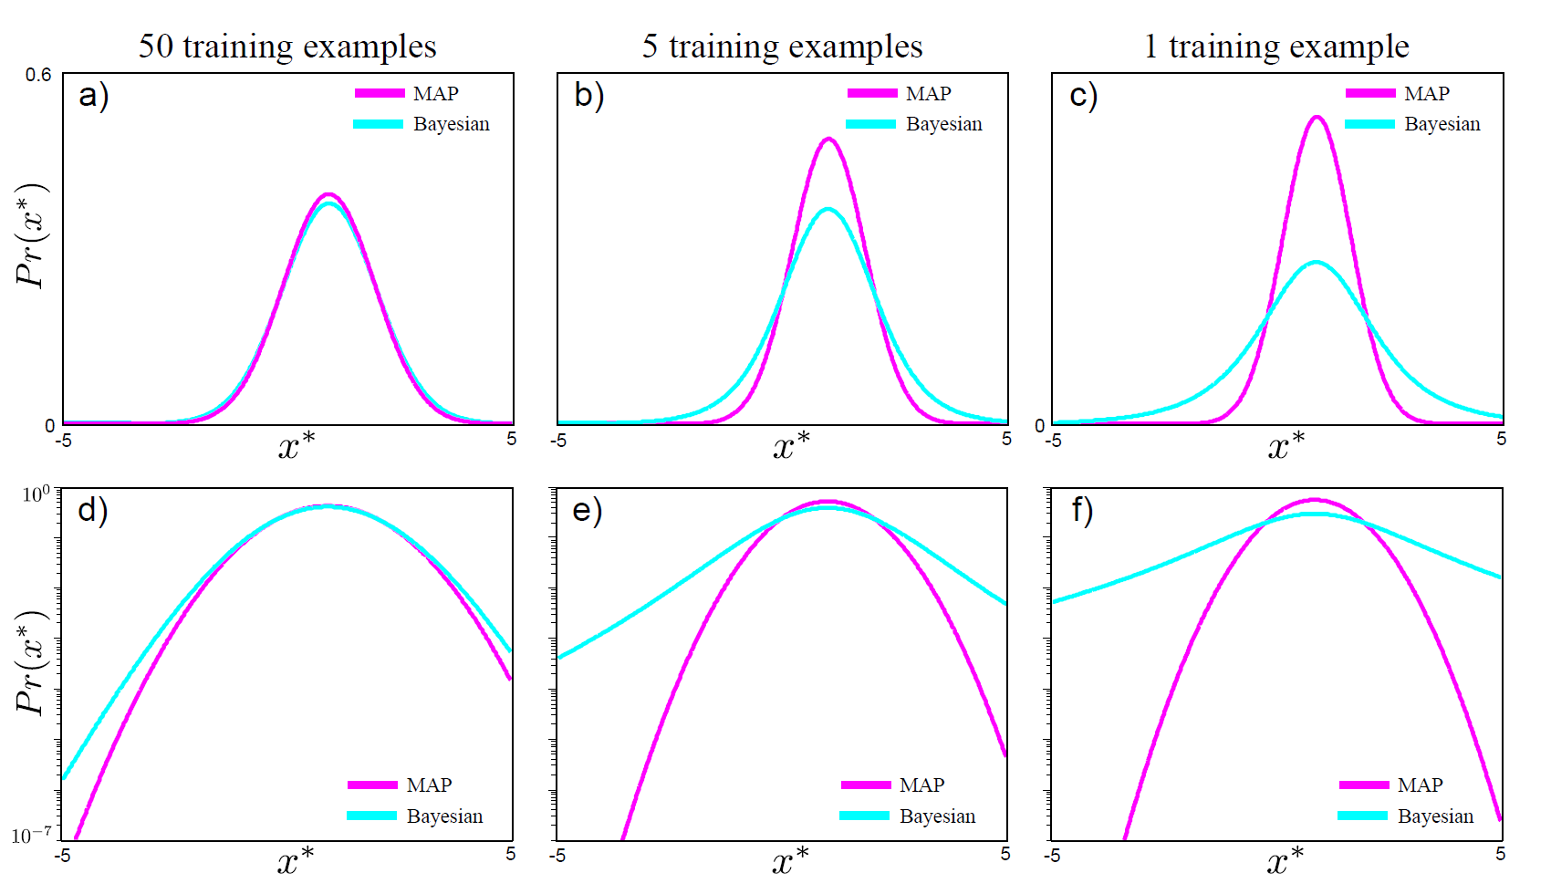
Posterior Predictive Distribution vs MAP Plug-In
Notes:
Here’s some examples again with 50, 5 or 1 training examples.
The blue curve corresponds to the posterior predictive distribution, while the purple curve corresponds to the MAP plug-in approximation of the posterior predictive distribution.
Notice that in each case, the posterior predictive distribution (the blue curves) are fatter than the MAP curve. So the MAP is overly confident.

Slide 48
Posterior Predictive Distribution vs MAP Plug-In
log-scale
Notes:
The difference between the MAP and posterior predictive distribution can be made more obvious by plotting the probability on a log scale.

Slide 49
Questions?
Notes:
Any questions before I continue?

Slide 50
Naive Bayes Classifier
Notes:
We are now ready to put together what we have learned in the past two weeks for the Naïve Bayes Classifier.

Slide 51
Naive Bayes Classifier I
Let y = target class label and x = feature vector of length D
Notes:
Just a reminder, let y be the target class label we are trying to predict.
x is the feature vector of length D. So D is the number of features

Slide 52
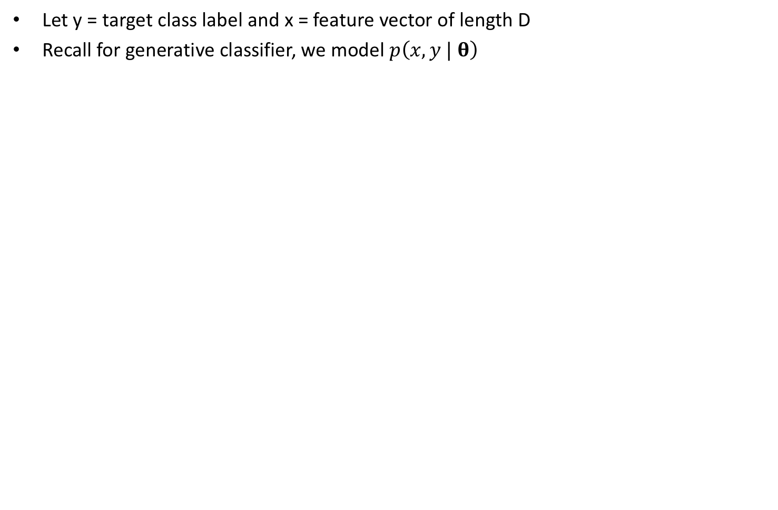
Naive Bayes Classifier I
Let y = target class label and x = feature vector of length D
Recall for generative classifier, we model $p\left(x, y | \text{θ}\right)$
Notes:
Recall that for a generative classifier, we model the joint distribution p of x and y parameterized by theta.

Slide 53
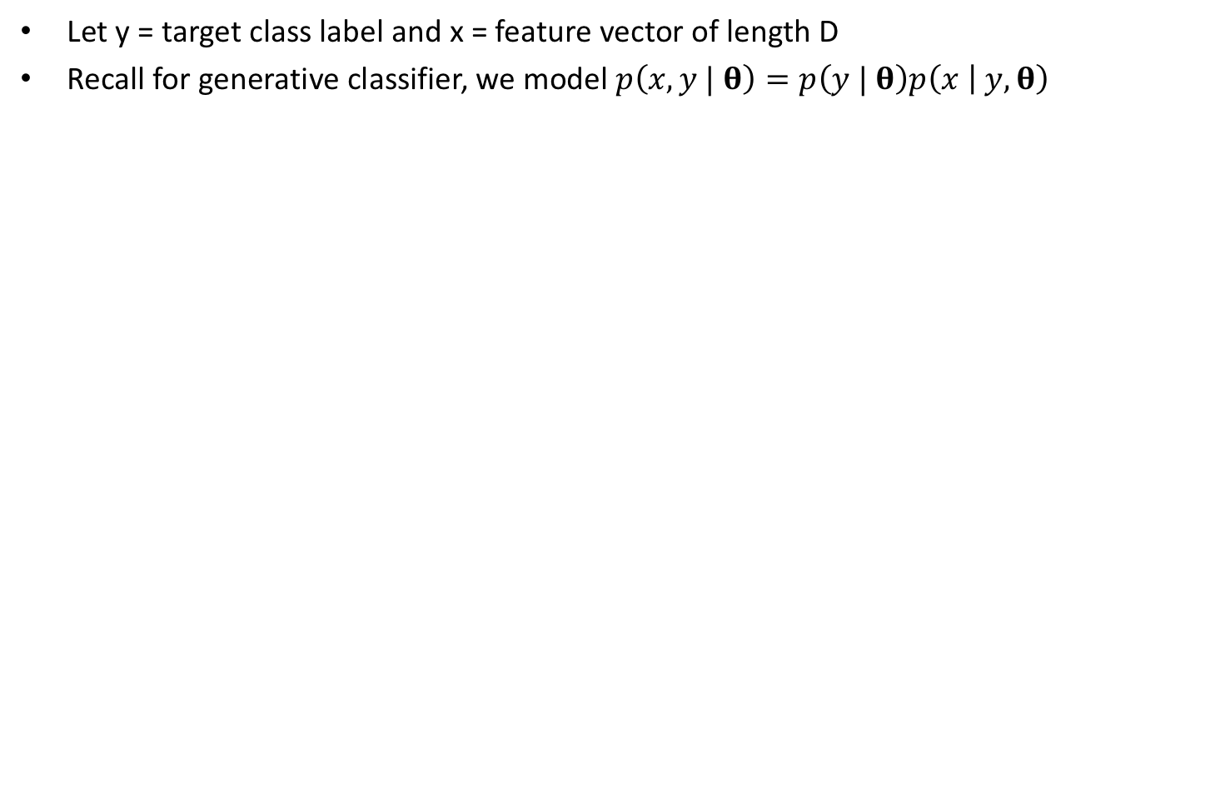
Naive Bayes Classifier I
Let y = target class label and x = feature vector of length D
Recall for generative classifier, we model $p\left(x, y | \text{θ}\right)=p\left(y | \text{θ}\right)p\left(x | y,\text{θ}\right)$
Notes:
Just using the rules of conditional probability, we can decompose the joint distribution into p of class label y given theta TIMES p of feature x given class label y and theta.

Slide 54
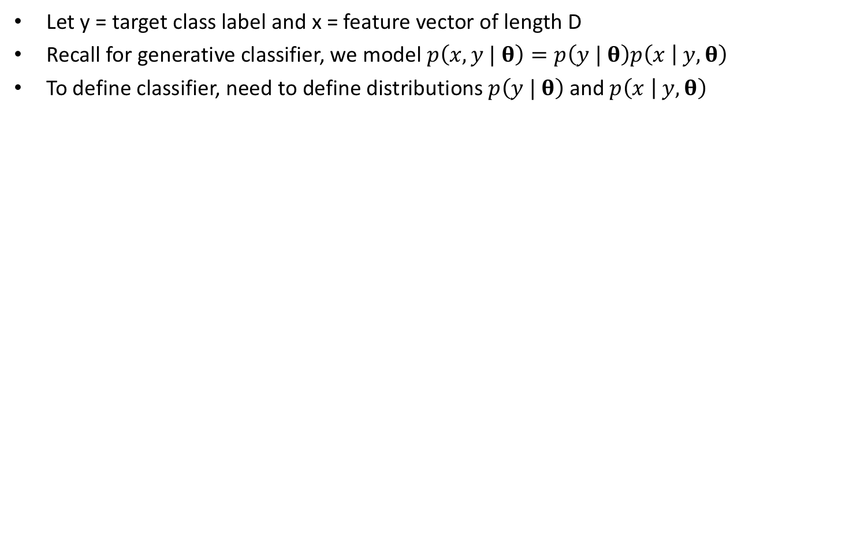
Naive Bayes Classifier I
Let y = target class label and x = feature vector of length D
Recall for generative classifier, we model $p\left(x, y | \text{θ}\right)=p\left(y | \text{θ}\right)p\left(x | y,\text{θ}\right)$
To define classifier, need to define distributions $p\left(y | \text{θ}\right)$ and $p\left(x | y,\text{θ}\right)$
Notes:
So to define the classifier, we need to specify the probability distributions of the two terms p of class label y given theta TIMES p of feature x given class label y and theta.

Slide 55
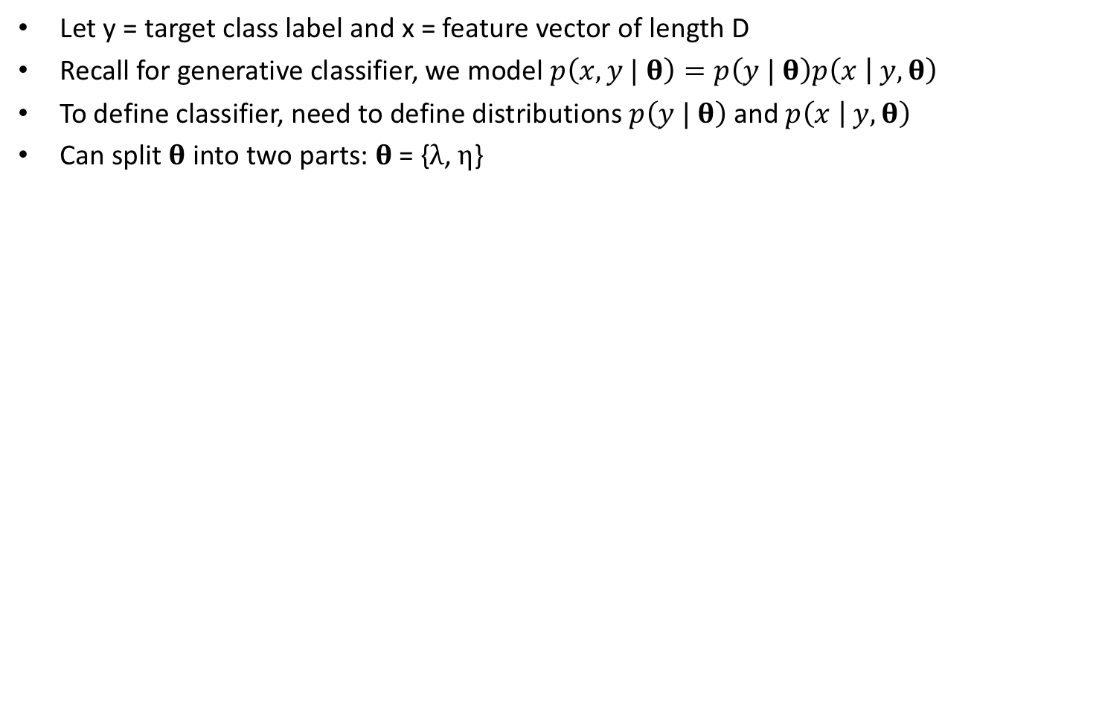
Naive Bayes Classifier I
Let y = target class label and x = feature vector of length D
Recall for generative classifier, we model $p\left(x, y | \text{θ}\right)=p\left(y | \text{θ}\right)p\left(x | y,\text{θ}\right)$
To define classifier, need to define distributions $p\left(y | \text{θ}\right)$ and $p\left(x | y,\text{θ}\right)$
Can split $\text{θ}$ into two parts: $\text{θ}\text{ = \{}λ\text{, }η\text{\}}$
Notes:
The first thing to do is to split theta into two parts lambda and eta.

Slide 56
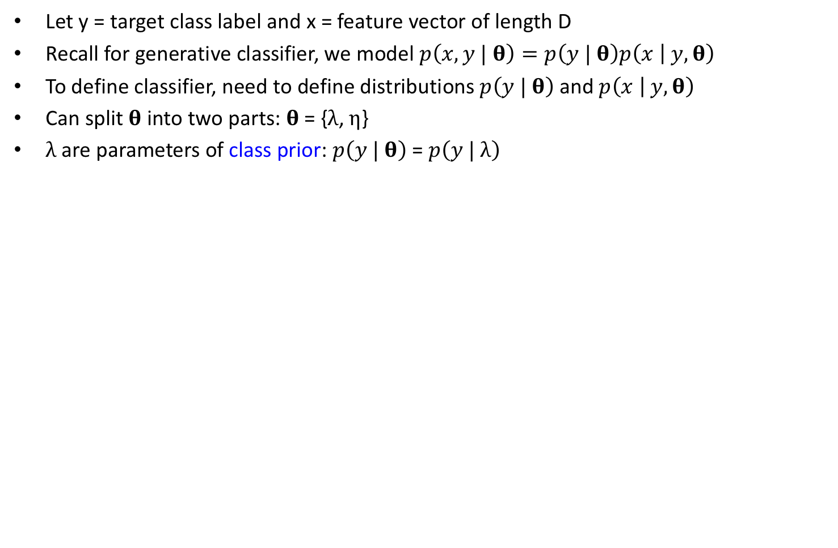
Naive Bayes Classifier I
Let y = target class label and x = feature vector of length D
Recall for generative classifier, we model $p\left(x, y | \text{θ}\right)=p\left(y | \text{θ}\right)p\left(x | y,\text{θ}\right)$
To define classifier, need to define distributions $p\left(y | \text{θ}\right)$ and $p\left(x | y,\text{θ}\right)$
Can split $\text{θ}$ into two parts: $\text{θ}\text{ = \{}λ\text{, }η\text{\}}$
$λ$are parameters of class prior: $p\left(y | \text{θ}\right)$ = $p\left(y | λ\right)$
Notes:
Lambda are the parameters of the class prior: p of class label y given lambda.

Slide 57
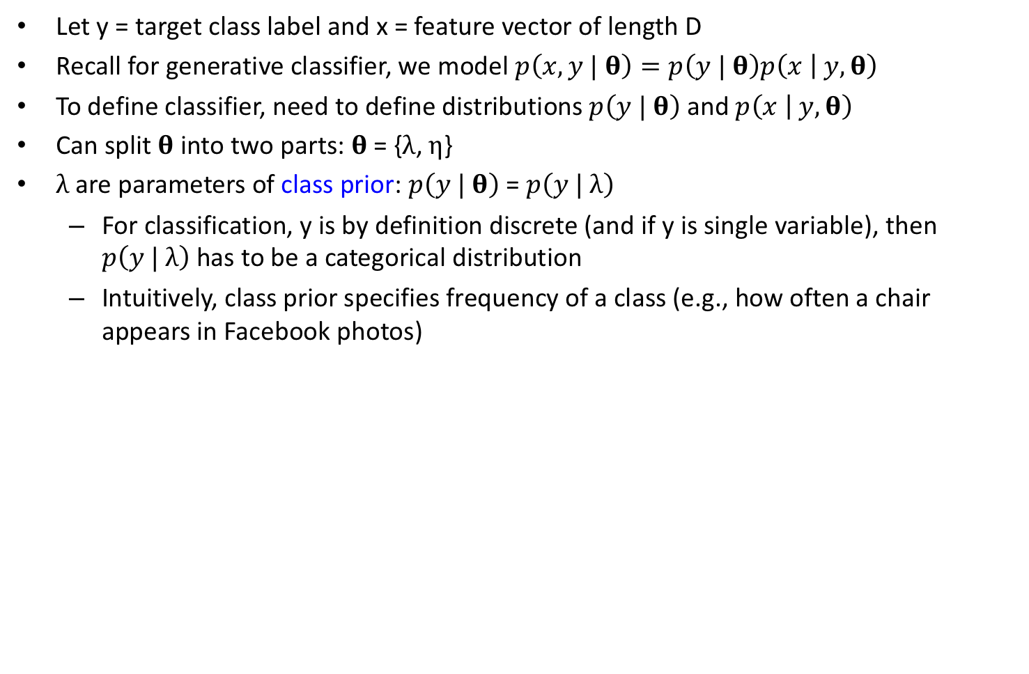
Naive Bayes Classifier I
Let y = target class label and x = feature vector of length D
Recall for generative classifier, we model $p\left(x, y | \text{θ}\right)=p\left(y | \text{θ}\right)p\left(x | y,\text{θ}\right)$
To define classifier, need to define distributions $p\left(y | \text{θ}\right)$ and $p\left(x | y,\text{θ}\right)$
Can split $\text{θ}$ into two parts: $\text{θ}\text{ = \{}λ\text{, }η\text{\}}$
$λ$are parameters of class prior: $p\left(y | \text{θ}\right)$ = $p\left(y | λ\right)$
For classification, y is by definition discrete (and if y is single variable), then $p\left(y | λ\right)$ has to be a categorical distribution
Intuitively, class prior specifies frequency of a class (e.g., how often a chair appears in Facebook photos)
Notes:
For classification y is by definition discrete. And if y is a single variable, then p of class label y given lambda is a categorical distribution.
Lambda tells us the frequency of different class labels, for example, how often a chair appears in Facebook photos

Slide 58
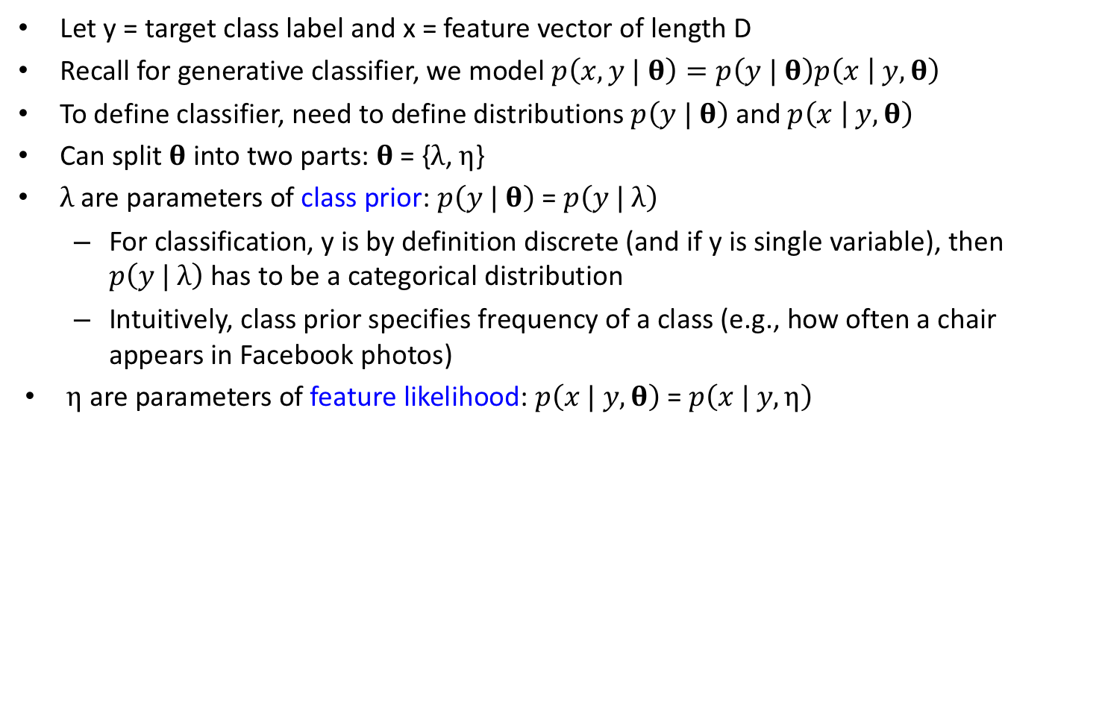
Naive Bayes Classifier I
Let y = target class label and x = feature vector of length D
Recall for generative classifier, we model $p\left(x, y | \text{θ}\right)=p\left(y | \text{θ}\right)p\left(x | y,\text{θ}\right)$
To define classifier, need to define distributions $p\left(y | \text{θ}\right)$ and $p\left(x | y,\text{θ}\right)$
Can split $\text{θ}$ into two parts: $\text{θ}\text{ = \{}λ\text{, }η\text{\}}$
$λ$are parameters of class prior: $p\left(y | \text{θ}\right)$ = $p\left(y | λ\right)$
For classification, y is by definition discrete (and if y is single variable), then $p\left(y | λ\right)$ has to be a categorical distribution
Intuitively, class prior specifies frequency of a class (e.g., how often a chair appears in Facebook photos)
$η$ are parameters of feature likelihood: $p\left(x | y, \text{θ}\right)$ = $p\left(x | y,η\right)$
Notes:
eta are the parameters of the feature likelihood: p of feature x given class label y and eta.

Slide 59
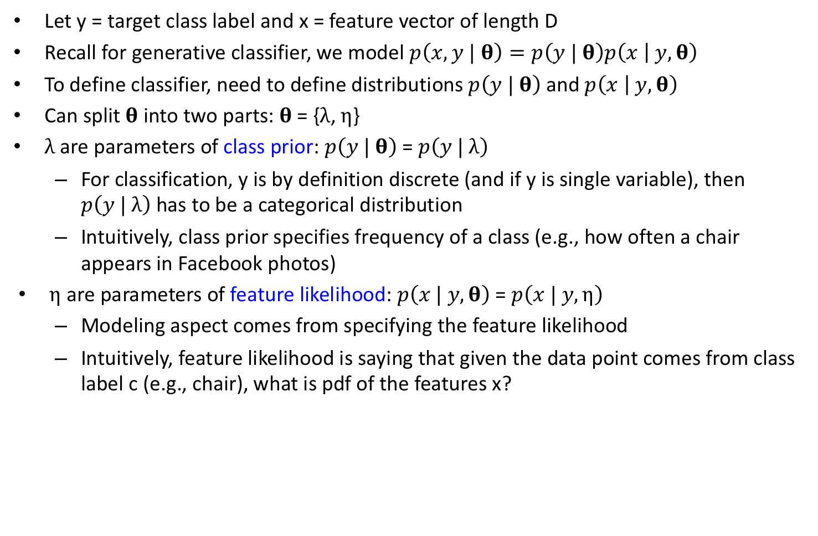
Naive Bayes Classifier I
Let y = target class label and x = feature vector of length D
Recall for generative classifier, we model $p\left(x, y | \text{θ}\right)=p\left(y | \text{θ}\right)p\left(x | y,\text{θ}\right)$
To define classifier, need to define distributions $p\left(y | \text{θ}\right)$ and $p\left(x | y,\text{θ}\right)$
Can split $\text{θ}$ into two parts: $\text{θ}\text{ = \{}λ\text{, }η\text{\}}$
$λ$are parameters of class prior: $p\left(y | \text{θ}\right)$ = $p\left(y | λ\right)$
For classification, y is by definition discrete (and if y is single variable), then $p\left(y | λ\right)$ has to be a categorical distribution
Intuitively, class prior specifies frequency of a class (e.g., how often a chair appears in Facebook photos)
$η$ are parameters of feature likelihood: $p\left(x | y, \text{θ}\right)$ = $p\left(x | y,η\right)$
Modeling aspect comes from specifying the feature likelihood
Intuitively, feature likelihood is saying that given the data point comes from class label c (e.g., chair), what is pdf of the features x?
Notes:
Because the class priors must be a category distribution, the modeling freedom comes from specifying the feature likelihood.
Intuitively, the feature likelihood is describing the probability distribution of the feature vector x, given that the data point comes from class label c.
For example, what is the probability distribution of a photo given that there is a chair in the photo.

Slide 60
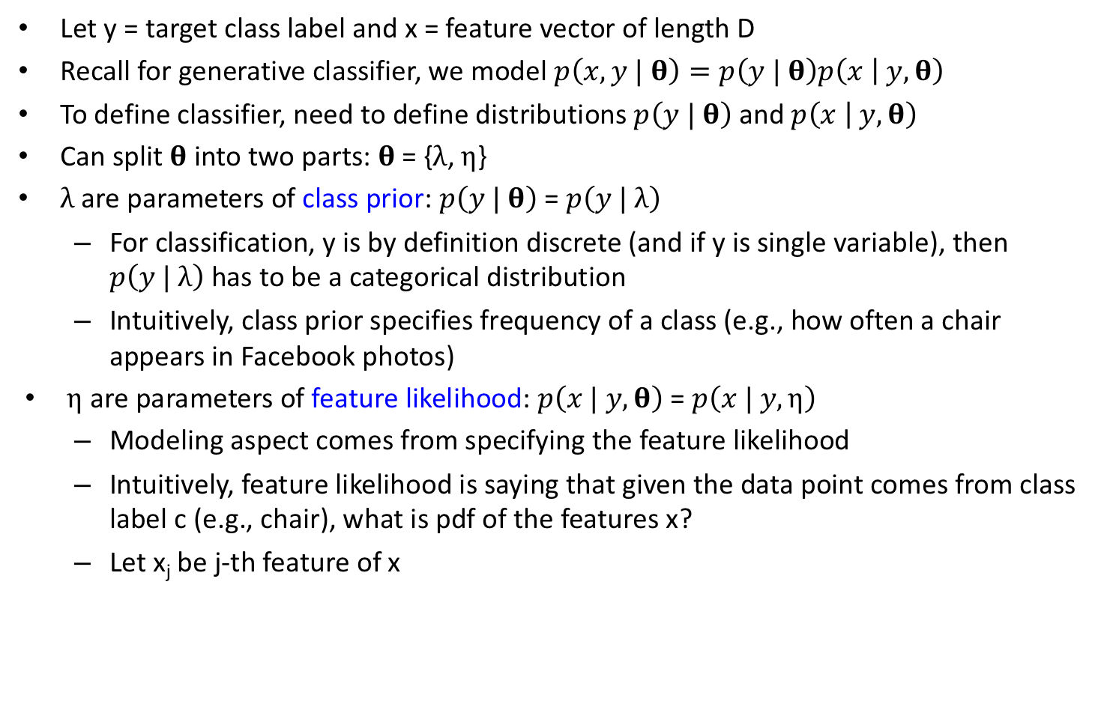
Naive Bayes Classifier I
Let y = target class label and x = feature vector of length D
Recall for generative classifier, we model $p\left(x, y | \text{θ}\right)=p\left(y | \text{θ}\right)p\left(x | y,\text{θ}\right)$
To define classifier, need to define distributions $p\left(y | \text{θ}\right)$ and $p\left(x | y,\text{θ}\right)$
Can split $\text{θ}$ into two parts: $\text{θ}\text{ = \{}λ\text{, }η\text{\}}$
$λ$are parameters of class prior: $p\left(y | \text{θ}\right)$ = $p\left(y | λ\right)$
For classification, y is by definition discrete (and if y is single variable), then $p\left(y | λ\right)$ has to be a categorical distribution
Intuitively, class prior specifies frequency of a class (e.g., how often a chair appears in Facebook photos)
$η$ are parameters of feature likelihood: $p\left(x | y, \text{θ}\right)$ = $p\left(x | y,η\right)$
Modeling aspect comes from specifying the feature likelihood
Intuitively, feature likelihood is saying that given the data point comes from class label c (e.g., chair), what is pdf of the features x?
Let x_{j} be j-th feature of x
Notes:
Let xj be the j-th feature of x

Slide 61
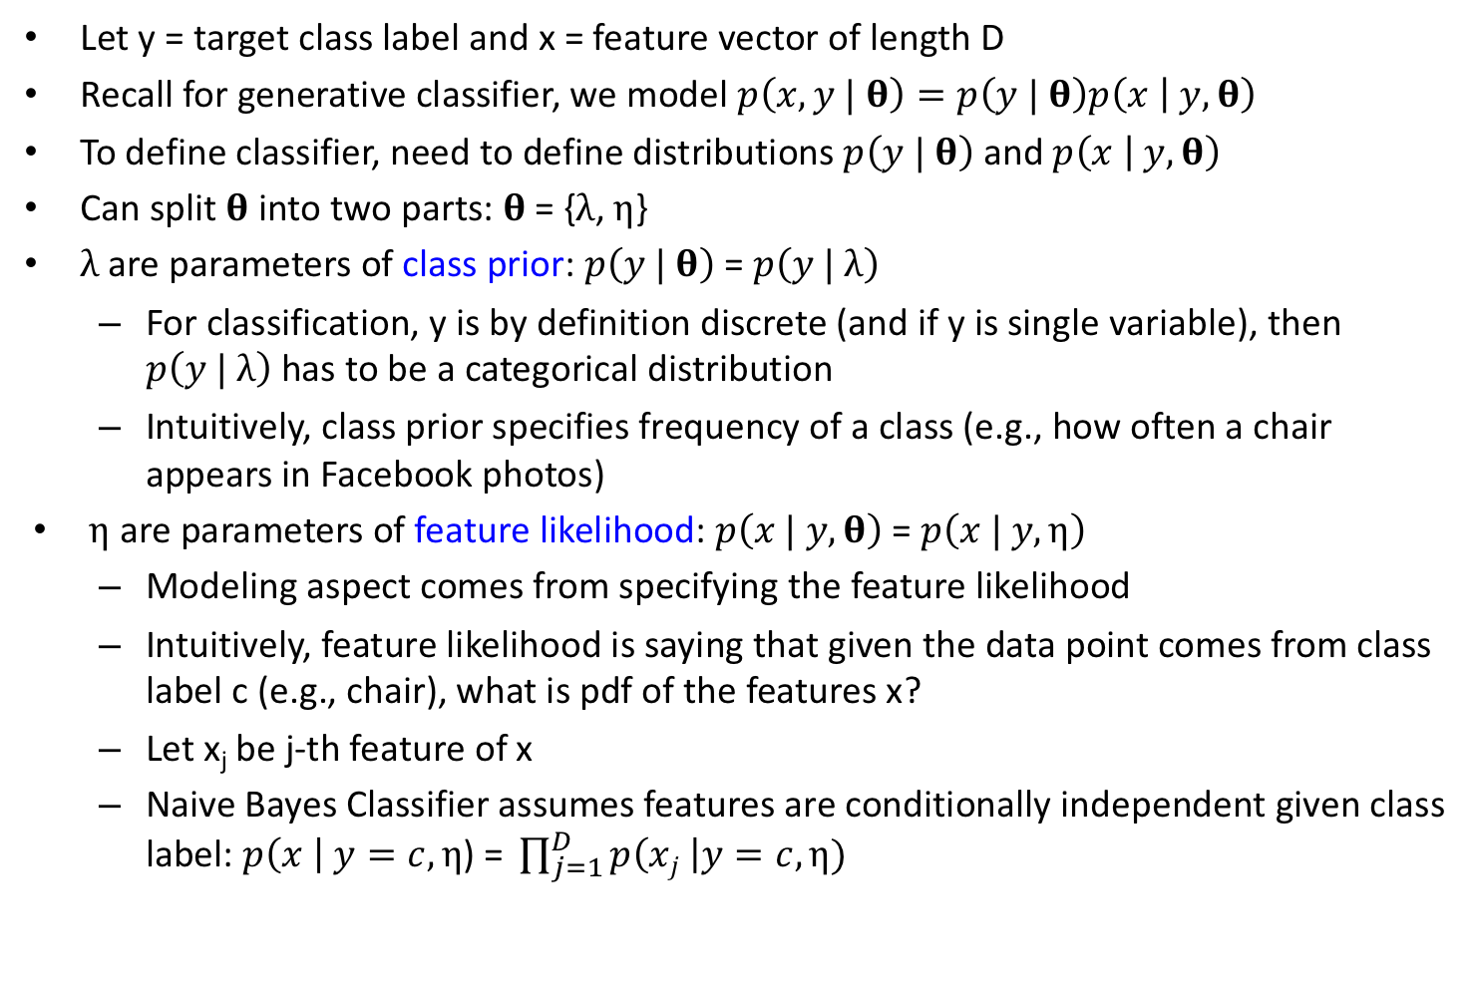
Naive Bayes Classifier I
Let y = target class label and x = feature vector of length D
Recall for generative classifier, we model $p\left(x, y | \text{θ}\right)=p\left(y | \text{θ}\right)p\left(x | y,\text{θ}\right)$
To define classifier, need to define distributions $p\left(y | \text{θ}\right)$ and $p\left(x | y,\text{θ}\right)$
Can split $\text{θ}$ into two parts: $\text{θ}\text{ = \{}λ\text{, }η\text{\}}$
$λ$are parameters of class prior: $p\left(y | \text{θ}\right)$ = $p\left(y | λ\right)$
For classification, y is by definition discrete (and if y is single variable), then $p\left(y | λ\right)$ has to be a categorical distribution
Intuitively, class prior specifies frequency of a class (e.g., how often a chair appears in Facebook photos)
$η$ are parameters of feature likelihood: $p\left(x | y, \text{θ}\right)$ = $p\left(x | y,η\right)$
Modeling aspect comes from specifying the feature likelihood
Intuitively, feature likelihood is saying that given the data point comes from class label c (e.g., chair), what is pdf of the features x?
Let x_{j} be j-th feature of x
Naive Bayes Classifier assumes features are conditionally independent given class label: $p\left(x \right| y=c,η\text{) = }\prod_{j=1}^{D}{p\left(xj \right|y=c,η)}$
Notes:
The Naïve Bayes Classifier assumes that conditioned on knowing the class label, the features are independent.
This means that p of feature vector x GIVEN that the class label is c is equal to the product from feature j = 1 to D p of xj GIVEN that the class label is c

Slide 62
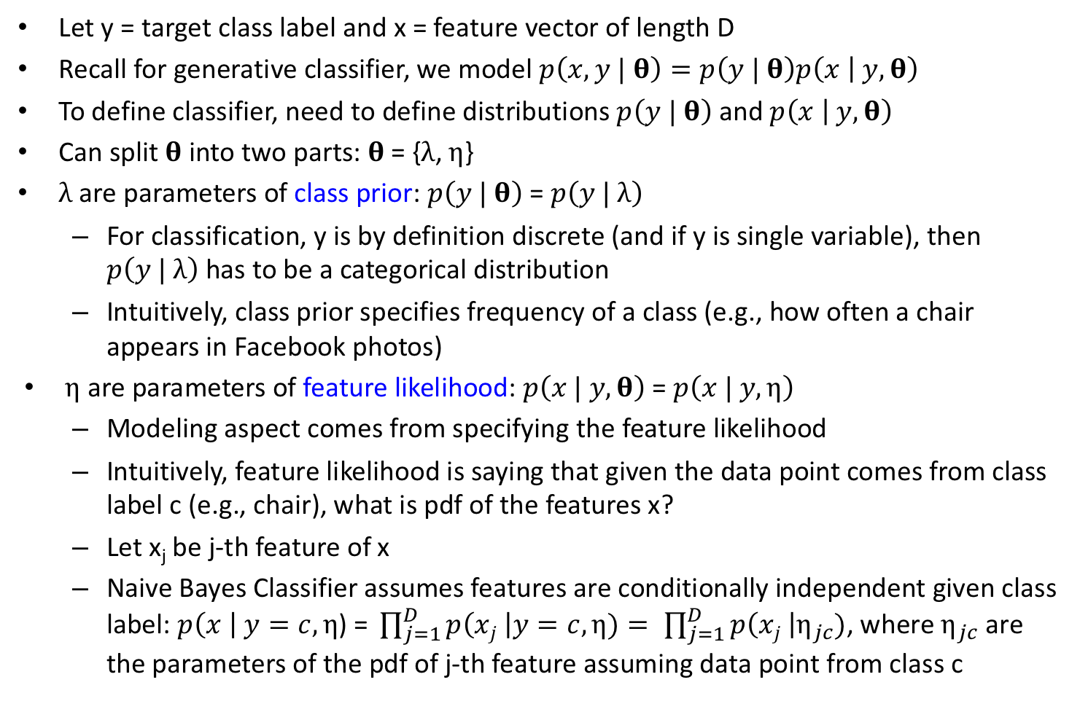
Naive Bayes Classifier I
Let y = target class label and x = feature vector of length D
Recall for generative classifier, we model $p\left(x, y | \text{θ}\right)=p\left(y | \text{θ}\right)p\left(x | y,\text{θ}\right)$
To define classifier, need to define distributions $p\left(y | \text{θ}\right)$ and $p\left(x | y,\text{θ}\right)$
Can split $\text{θ}$ into two parts: $\text{θ}\text{ = \{}λ\text{, }η\text{\}}$
$λ$are parameters of class prior: $p\left(y | \text{θ}\right)$ = $p\left(y | λ\right)$
For classification, y is by definition discrete (and if y is single variable), then $p\left(y | λ\right)$ has to be a categorical distribution
Intuitively, class prior specifies frequency of a class (e.g., how often a chair appears in Facebook photos)
$η$ are parameters of feature likelihood: $p\left(x | y, \text{θ}\right)$ = $p\left(x | y,η\right)$
Modeling aspect comes from specifying the feature likelihood
Intuitively, feature likelihood is saying that given the data point comes from class label c (e.g., chair), what is pdf of the features x?
Let x_{j} be j-th feature of x
Naive Bayes Classifier assumes features are conditionally independent given class label: $p\left(x \right| y=c,η\text{) = }\prod_{j=1}^{D}{p\left(xj \right|y=c,η)}= \prod_{j=1}^{D}{p\left(xj \right|η_{jc})}$, where $η_{jc}$ are the parameters of the pdf of j-th feature assuming data point from class c
Notes:
This is in turn equal to the product from j = 1 to D, p of xj given eta jc.
Here, eta jc are the parameters of the pdf of the j-feature given that the data point comes from class c.
Let’s unpack a little more.

Slide 63
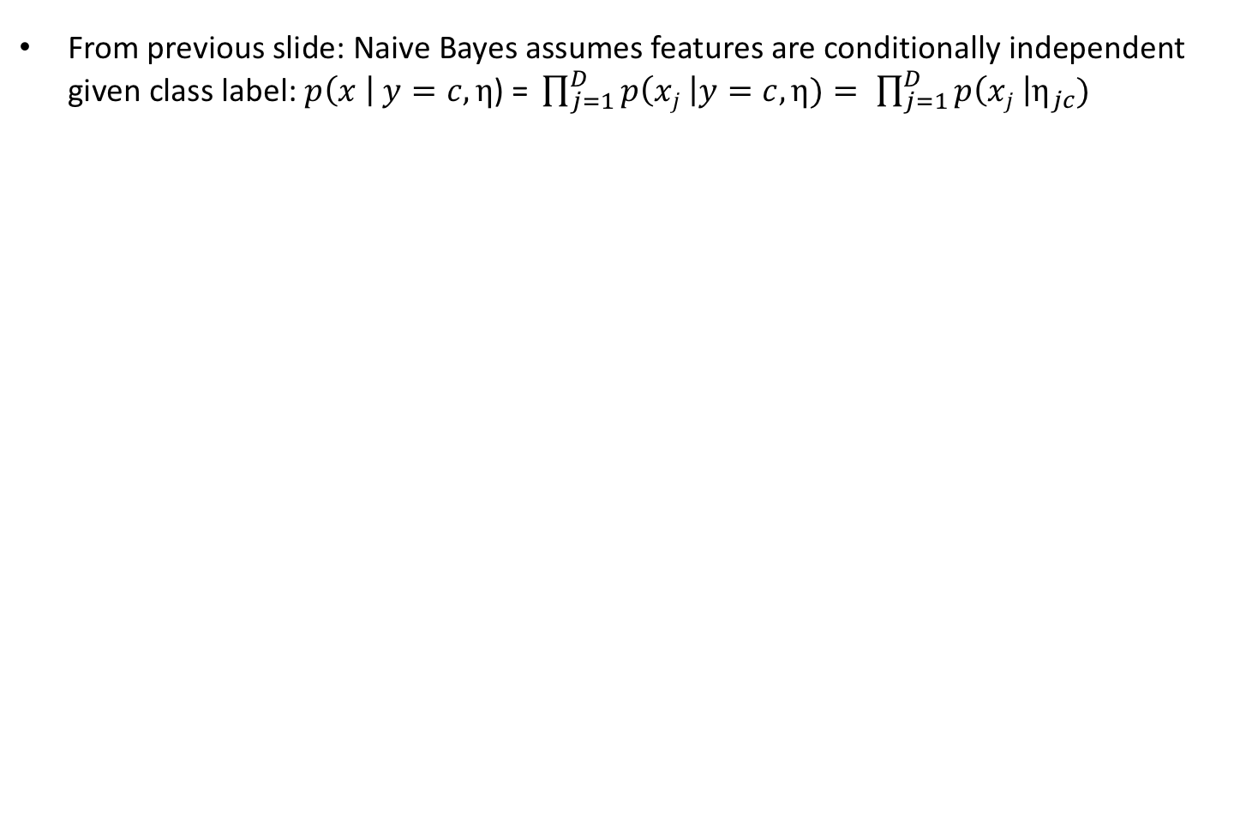
Naive Bayes Classifier II
From previous slide: Naive Bayes assumes features are conditionally independent given class label:$p\left(x \right| y=c,η\text{) = }\prod_{j=1}^{D}{p\left(xj \right|y=c,η)}= \prod_{j=1}^{D}{p\left(xj \right|η_{jc})}$
Notes:
This first bullet point is copied from the previous slide.

Slide 64
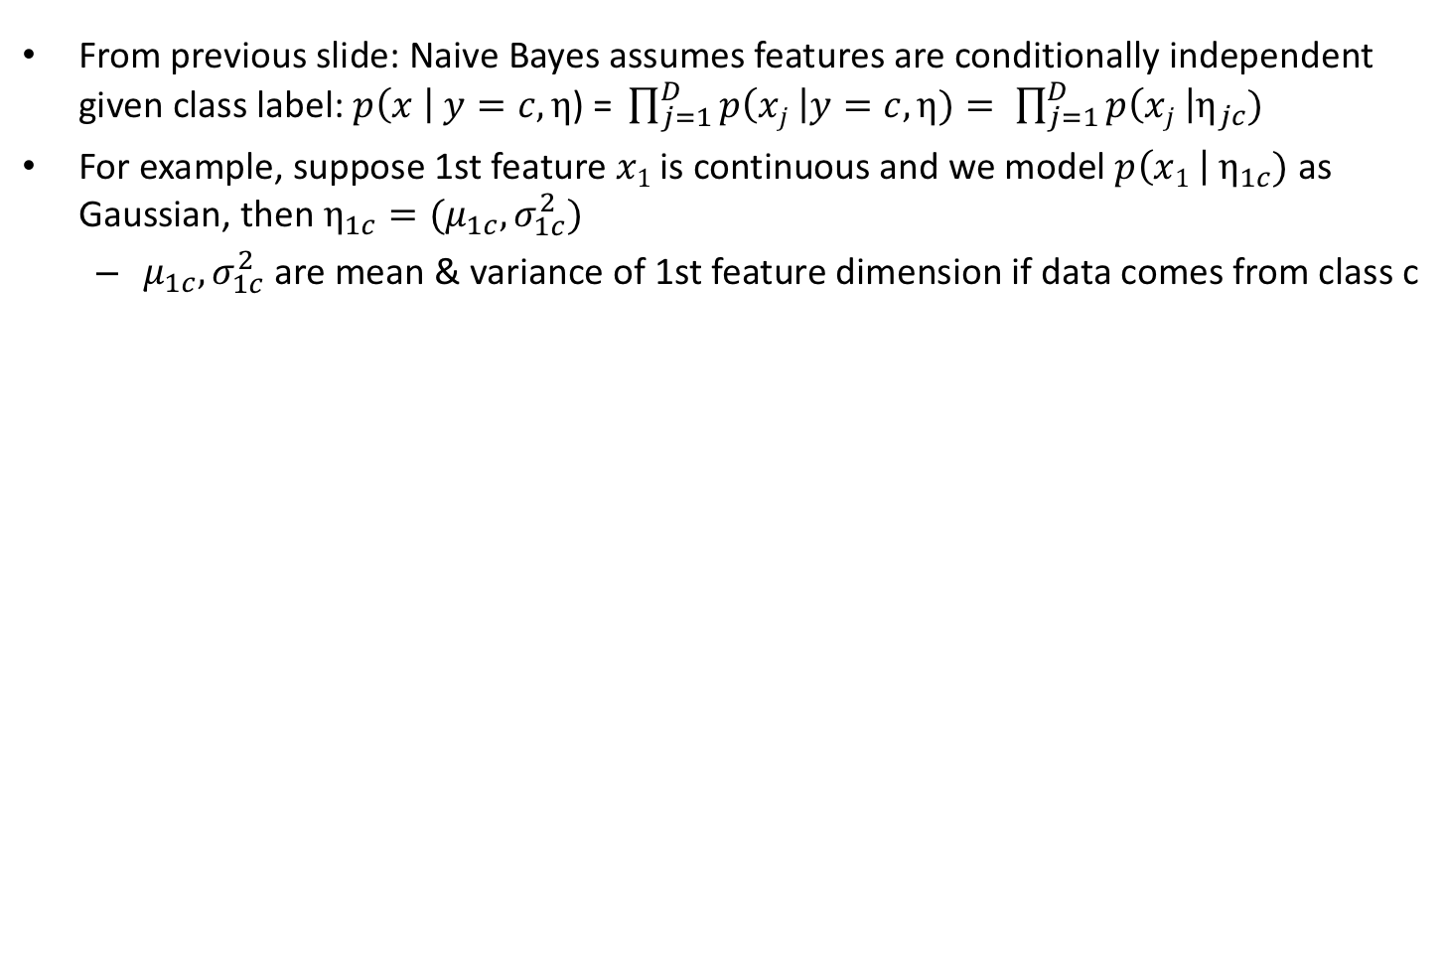
Naive Bayes Classifier II
From previous slide: Naive Bayes assumes features are conditionally independent given class label:$p\left(x \right| y=c,η\text{) = }\prod_{j=1}^{D}{p\left(xj \right|y=c,η)}= \prod_{j=1}^{D}{p\left(xj \right|η_{jc})}$
For example, suppose 1st feature $x1$ is continuous and we model $p\left(x1 \right|{ η}_{1c})$ as Gaussian, then $η_{1c}=(μ_{1c},σ_{1c}^{2})$
$μ_{1c},σ_{1c}^{2}$ are mean & variance of 1st feature dimension if data comes from class c
Notes:
For example, suppose the first feature x1 is continuous, so we model p of x1 given eta 1c as Gaussian, then eta 1c actually corresponds to mean mu 1c and variance sigma square 1c.
We can think of mu 1c and sigma square 1c as the mean and variance of the first feature dimension for data coming from class c.

Slide 65
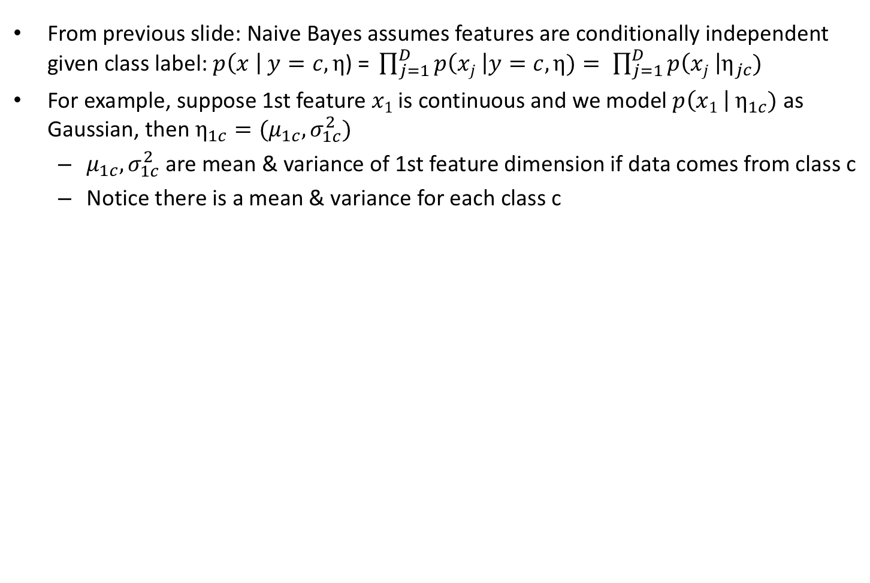
Naive Bayes Classifier II
From previous slide: Naive Bayes assumes features are conditionally independent given class label:$p\left(x \right| y=c,η\text{) = }\prod_{j=1}^{D}{p\left(xj \right|y=c,η)}= \prod_{j=1}^{D}{p\left(xj \right|η_{jc})}$
For example, suppose 1st feature $x1$ is continuous and we model $p\left(x1 \right|{ η}_{1c})$ as Gaussian, then $η_{1c}=(μ_{1c},σ_{1c}^{2})$
$μ_{1c},σ_{1c}^{2}$ are mean & variance of 1st feature dimension if data comes from class c
Notice there is a mean & variance for each class c
Notes:
Notice that there is a mean and variance for each class c.

Slide 66
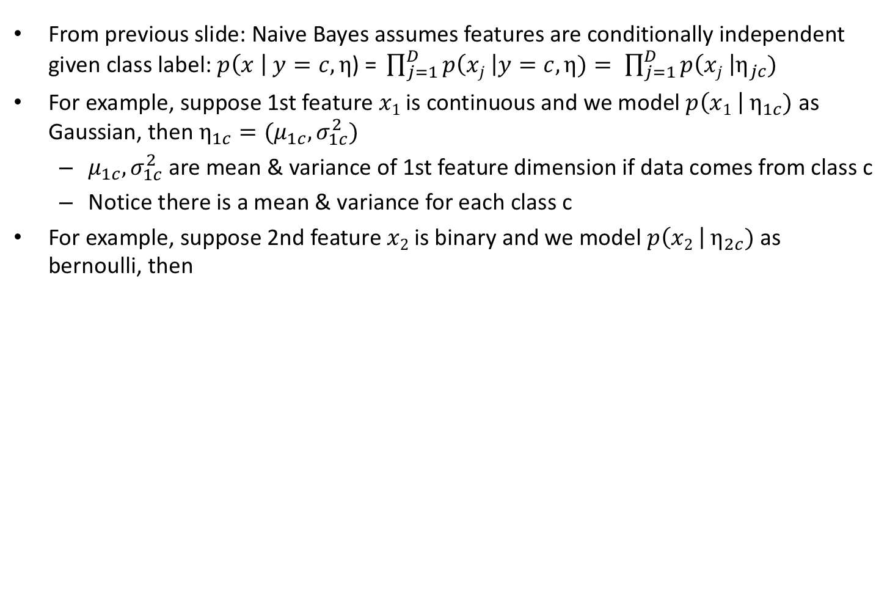
Naive Bayes Classifier II
From previous slide: Naive Bayes assumes features are conditionally independent given class label:$p\left(x \right| y=c,η\text{) = }\prod_{j=1}^{D}{p\left(xj \right|y=c,η)}= \prod_{j=1}^{D}{p\left(xj \right|η_{jc})}$
For example, suppose 1st feature $x1$ is continuous and we model $p\left(x1 \right|{ η}_{1c})$ as Gaussian, then $η_{1c}=(μ_{1c},σ_{1c}^{2})$
$μ_{1c},σ_{1c}^{2}$ are mean & variance of 1st feature dimension if data comes from class c
Notice there is a mean & variance for each class c
For example, suppose 2nd feature $x2$ is binary and we model $p\left(x2 \right| η_{2c})$ as bernoulli, then
Notes:
For example, suppose the second feature x2 is binary, so we model p of x2 given eta 2c as bernoulli, then

Slide 67
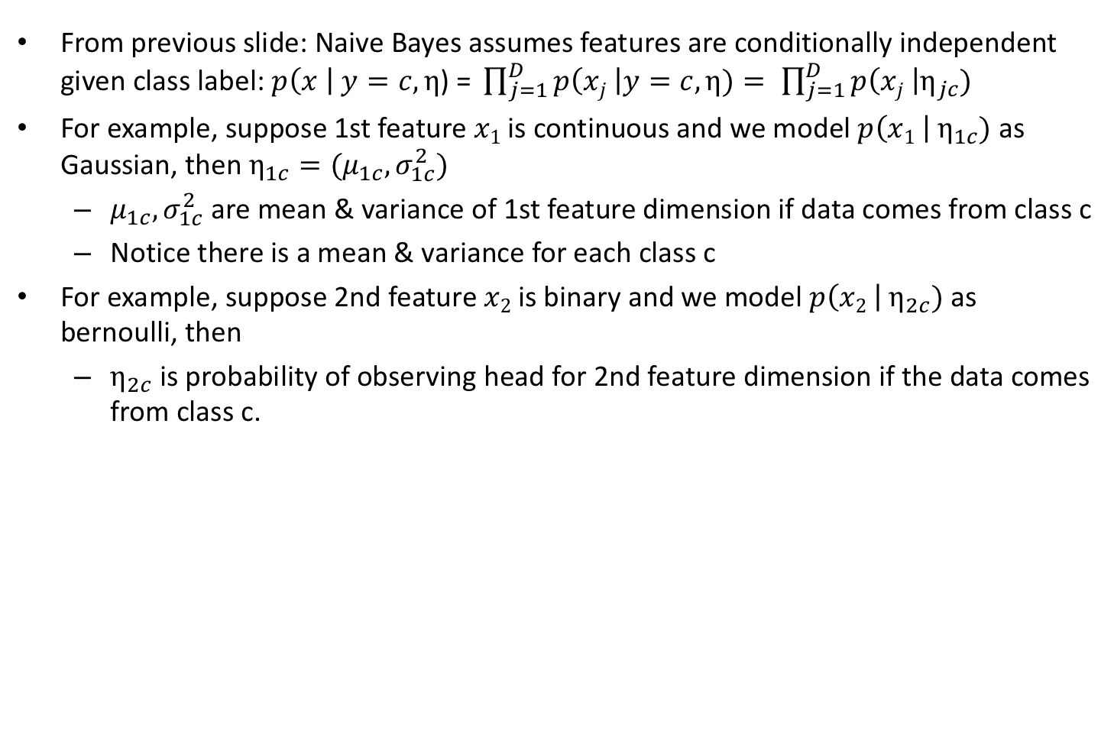
Naive Bayes Classifier II
From previous slide: Naive Bayes assumes features are conditionally independent given class label:$p\left(x \right| y=c,η\text{) = }\prod_{j=1}^{D}{p\left(xj \right|y=c,η)}= \prod_{j=1}^{D}{p\left(xj \right|η_{jc})}$
For example, suppose 1st feature $x1$ is continuous and we model $p\left(x1 \right|{ η}_{1c})$ as Gaussian, then $η_{1c}=(μ_{1c},σ_{1c}^{2})$
$μ_{1c},σ_{1c}^{2}$ are mean & variance of 1st feature dimension if data comes from class c
Notice there is a mean & variance for each class c
For example, suppose 2nd feature $x2$ is binary and we model $p\left(x2 \right| η_{2c})$ as bernoulli, then
$η_{2c}$ is probability of observing head for 2nd feature dimension if the data comes from class c.
Notes:
Then eta 2c is the probability of observing head for 2nd feature dimension given that the data comes from class c.

Slide 68
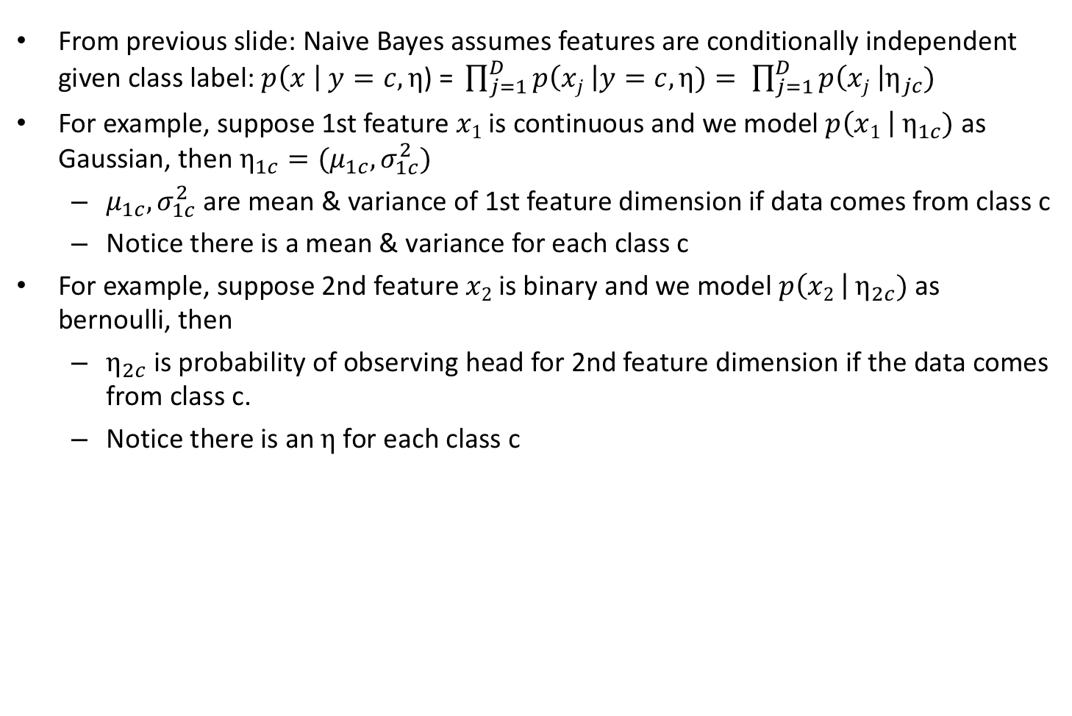
Naive Bayes Classifier II
From previous slide: Naive Bayes assumes features are conditionally independent given class label:$p\left(x \right| y=c,η\text{) = }\prod_{j=1}^{D}{p\left(xj \right|y=c,η)}= \prod_{j=1}^{D}{p\left(xj \right|η_{jc})}$
For example, suppose 1st feature $x1$ is continuous and we model $p\left(x1 \right|{ η}_{1c})$ as Gaussian, then $η_{1c}=(μ_{1c},σ_{1c}^{2})$
$μ_{1c},σ_{1c}^{2}$ are mean & variance of 1st feature dimension if data comes from class c
Notice there is a mean & variance for each class c
For example, suppose 2nd feature $x2$ is binary and we model $p\left(x2 \right| η_{2c})$ as bernoulli, then
$η_{2c}$ is probability of observing head for 2nd feature dimension if the data comes from class c.
Notice there is an $η$for each class c
Notes:
Again there is an eta for every class c we are trying to predict.

Slide 69
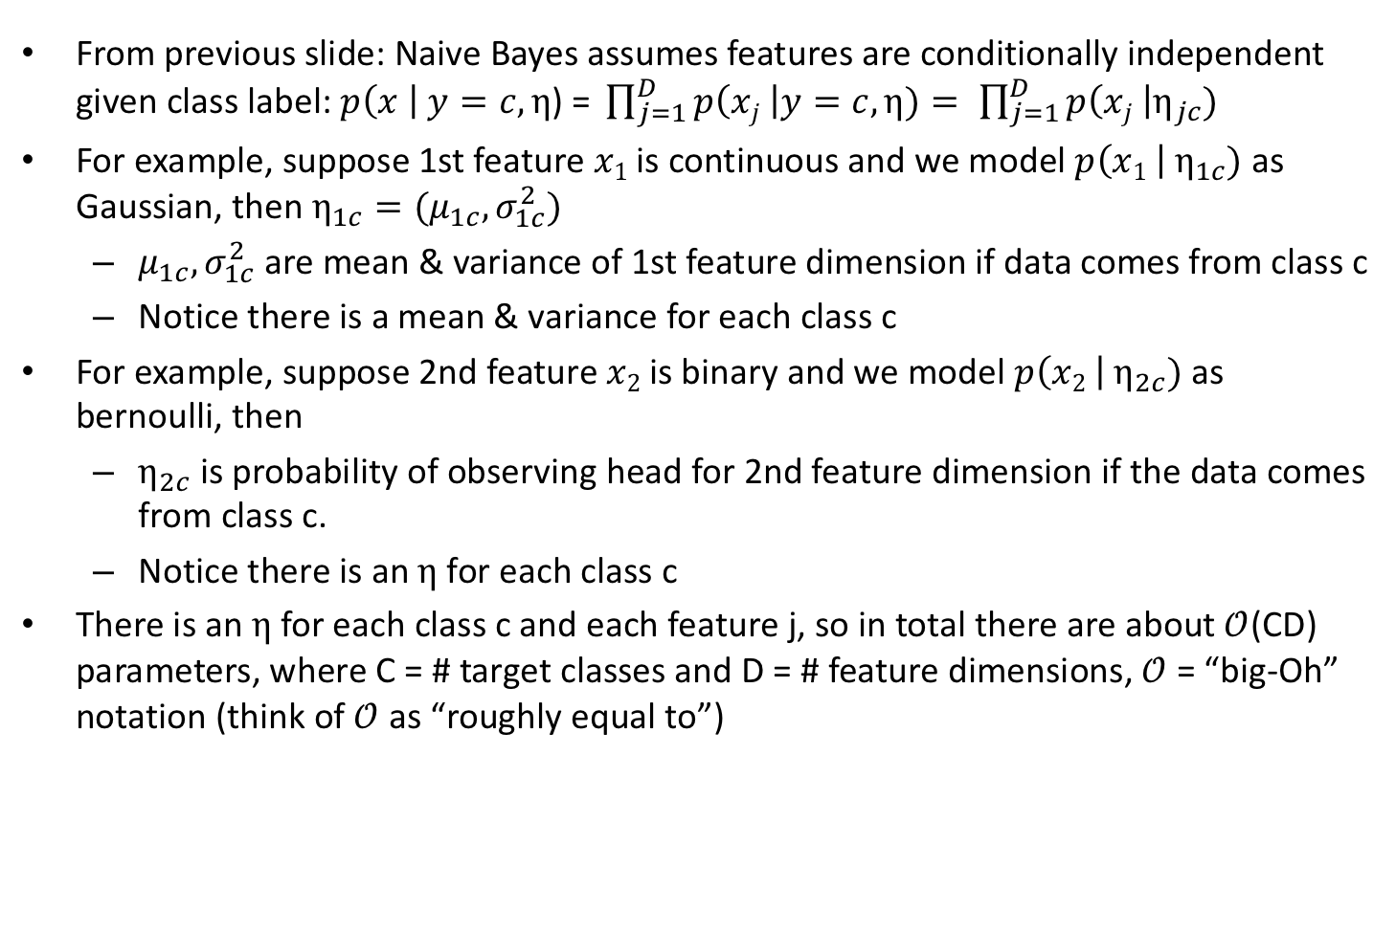
Naive Bayes Classifier II
From previous slide: Naive Bayes assumes features are conditionally independent given class label:$p\left(x \right| y=c,η\text{) = }\prod_{j=1}^{D}{p\left(xj \right|y=c,η)}= \prod_{j=1}^{D}{p\left(xj \right|η_{jc})}$
For example, suppose 1st feature $x1$ is continuous and we model $p\left(x1 \right|{ η}_{1c})$ as Gaussian, then $η_{1c}=(μ_{1c},σ_{1c}^{2})$
$μ_{1c},σ_{1c}^{2}$ are mean & variance of 1st feature dimension if data comes from class c
Notice there is a mean & variance for each class c
For example, suppose 2nd feature $x2$ is binary and we model $p\left(x2 \right| η_{2c})$ as bernoulli, then
$η_{2c}$ is probability of observing head for 2nd feature dimension if the data comes from class c.
Notice there is an $η$for each class c
There is an $η$for each class c and each feature j, so in total there are about $𝒪$(CD) parameters, where C = # target classes and D = # feature dimensions, $𝒪$ = “big-Oh” notation (think of $𝒪$ as “roughly equal to”)
Notes:
There is an eta for each class c and each feature j, so in total, there are about C TIMES D parameters in the model.
C is the number of classes we are trying to predict. D is the number of feature dimensions.
O is the big-oh notation. If you don’t know what big-Oh is, you can think of big-Oh as roughly equal to. I won’t go into it in details, but if you are interested, there is a reference at the end of the lecture notes, where you can learn more.

Slide 70
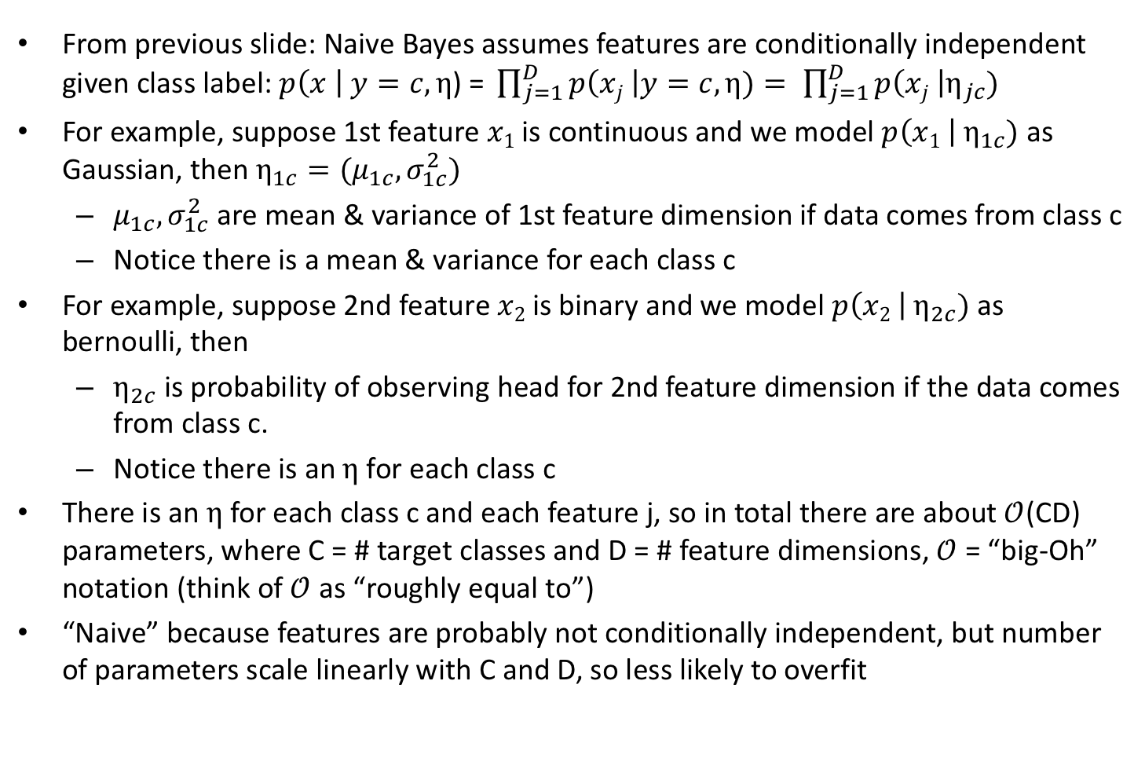
Naive Bayes Classifier II
From previous slide: Naive Bayes assumes features are conditionally independent given class label:$p\left(x \right| y=c,η\text{) = }\prod_{j=1}^{D}{p\left(xj \right|y=c,η)}= \prod_{j=1}^{D}{p\left(xj \right|η_{jc})}$
For example, suppose 1st feature $x1$ is continuous and we model $p\left(x1 \right|{ η}_{1c})$ as Gaussian, then $η_{1c}=(μ_{1c},σ_{1c}^{2})$
$μ_{1c},σ_{1c}^{2}$ are mean & variance of 1st feature dimension if data comes from class c
Notice there is a mean & variance for each class c
For example, suppose 2nd feature $x2$ is binary and we model $p\left(x2 \right| η_{2c})$ as bernoulli, then
$η_{2c}$ is probability of observing head for 2nd feature dimension if the data comes from class c.
Notice there is an $η$for each class c
There is an $η$for each class c and each feature j, so in total there are about $𝒪$(CD) parameters, where C = # target classes and D = # feature dimensions, $𝒪$ = “big-Oh” notation (think of $𝒪$ as “roughly equal to”)
“Naive” because features are probably not conditionally independent, but number of parameters scale linearly with C and D, so less likely to overfit
Notes:
The naïve bayes classifier is called “Naive” because in reality, the different feature dimensions are probably not conditionally independent.
But because the number of parameters scale linearly with C and D, so it’s less likely to overfit

Slide 71
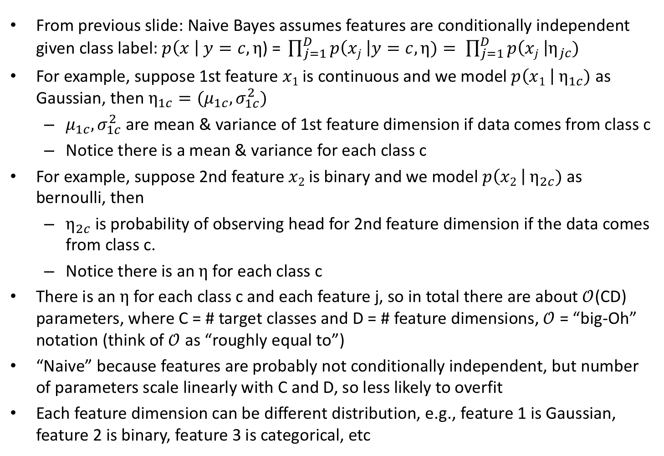
Naive Bayes Classifier II
From previous slide: Naive Bayes assumes features are conditionally independent given class label:$p\left(x \right| y=c,η\text{) = }\prod_{j=1}^{D}{p\left(xj \right|y=c,η)}= \prod_{j=1}^{D}{p\left(xj \right|η_{jc})}$
For example, suppose 1st feature $x1$ is continuous and we model $p\left(x1 \right|{ η}_{1c})$ as Gaussian, then $η_{1c}=(μ_{1c},σ_{1c}^{2})$
$μ_{1c},σ_{1c}^{2}$ are mean & variance of 1st feature dimension if data comes from class c
Notice there is a mean & variance for each class c
For example, suppose 2nd feature $x2$ is binary and we model $p\left(x2 \right| η_{2c})$ as bernoulli, then
$η_{2c}$ is probability of observing head for 2nd feature dimension if the data comes from class c.
Notice there is an $η$for each class c
There is an $η$for each class c and each feature j, so in total there are about $𝒪$(CD) parameters, where C = # target classes and D = # feature dimensions, $𝒪$ = “big-Oh” notation (think of $𝒪$ as “roughly equal to”)
“Naive” because features are probably not conditionally independent, but number of parameters scale linearly with C and D, so less likely to overfit
Each feature dimension can be different distribution, e.g., feature 1 is Gaussian, feature 2 is binary, feature 3 is categorical, etc
Notes:
Each feature dimension can follow a different probability distribution. For example, the first feature can be Gaussian, second feature can be binary, third feature can be categorical and so on.

Slide 72
Questions?
Notes:
Any questions before I talk about how to estimate the naïve bayes parameters and classify a new data point?

Slide 73
Three Strategies for estimating Naive Bayes Parameters & Classifying New Sample
Given training set D = {x_{ij}, y_{i}}_{i=1:N, j=1:D}, where x_{ij} is j-th feature of i-th data point (e.g., i-th photo) and y_{i} is the target class label (e.g., chair) of i-th data point
Notes:
Big picture time. Let’s talk about what we are trying to do now.
This slide is actually similar to a slide from last week. We have a training dataset D, consisting of a bunch of xij and yi.
xij is the j-th feature of the i-th datapoint.
Yi is the class label of the i-th datapoint.

Slide 74
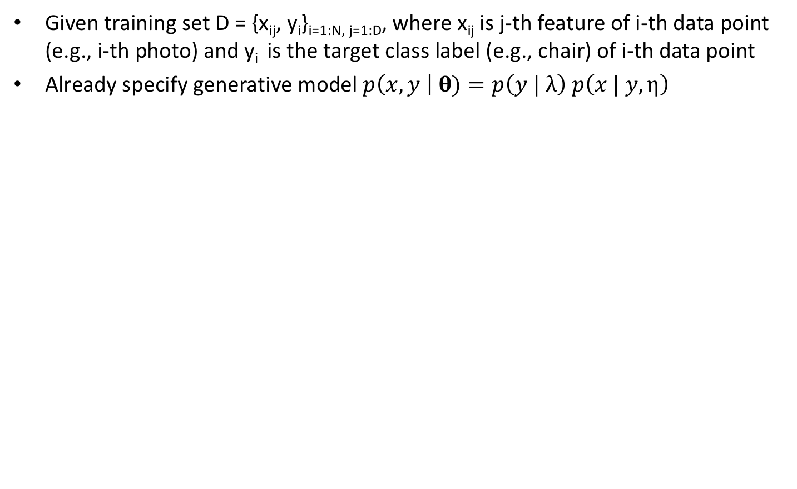
Three Strategies for estimating Naive Bayes Parameters & Classifying New Sample
Given training set D = {x_{ij}, y_{i}}_{i=1:N, j=1:D}, where x_{ij} is j-th feature of i-th data point (e.g., i-th photo) and y_{i} is the target class label (e.g., chair) of i-th data point
Already specify generative model $p\left(x, y \right| \text{θ})=p\left(y | λ\right)$ $p\left(x | y,η\right)$
Notes:
We have already specified the generative model, which consists of two sets of parameters lambda and eta.
Lambda parameterizes the class prior distribution. eta parametrized the feature likelihood distribution.

Slide 75
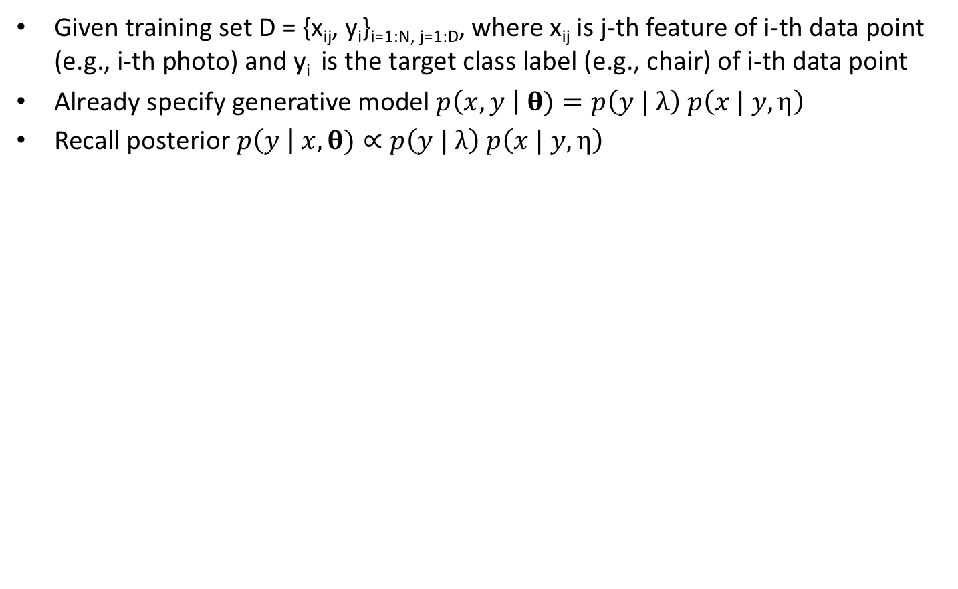
Three Strategies for estimating Naive Bayes Parameters & Classifying New Sample
Given training set D = {x_{ij}, y_{i}}_{i=1:N, j=1:D}, where x_{ij} is j-th feature of i-th data point (e.g., i-th photo) and y_{i} is the target class label (e.g., chair) of i-th data point
Already specify generative model $p\left(x, y \right| \text{θ})=p\left(y | λ\right)$ $p\left(x | y,η\right)$
Recall posterior $p\left(y \right| x,\text{θ})∝p\left(y | λ\right) p\left(x | y,η\right)$
Notes:
We want to classify a new feature vector x using MAP estimation, so recall that the posterior distribution of class label y given x and theta is proportional to the class prior TIMES the feature likelihood.
These two terms are the same as the generative model

Slide 76
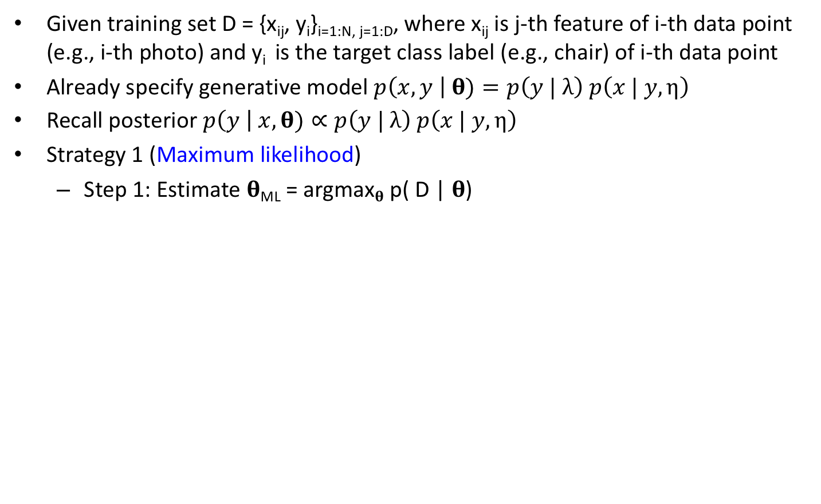
Three Strategies for estimating Naive Bayes Parameters & Classifying New Sample
Given training set D = {x_{ij}, y_{i}}_{i=1:N, j=1:D}, where x_{ij} is j-th feature of i-th data point (e.g., i-th photo) and y_{i} is the target class label (e.g., chair) of i-th data point
Already specify generative model $p\left(x, y \right| \text{θ})=p\left(y | λ\right)$ $p\left(x | y,η\right)$
Recall posterior $p\left(y \right| x,\text{θ})∝p\left(y | λ\right) p\left(x | y,η\right)$
Strategy 1 (Maximum likelihood)
Step 1: Estimate 𝛉_{ML} = argmax_{𝛉} p( D | 𝛉)
Notes:
There are three strategies that we can perform this classification.
In the first strategy, we first perform maximum likelihood estimation of theta using the training data.

Slide 77
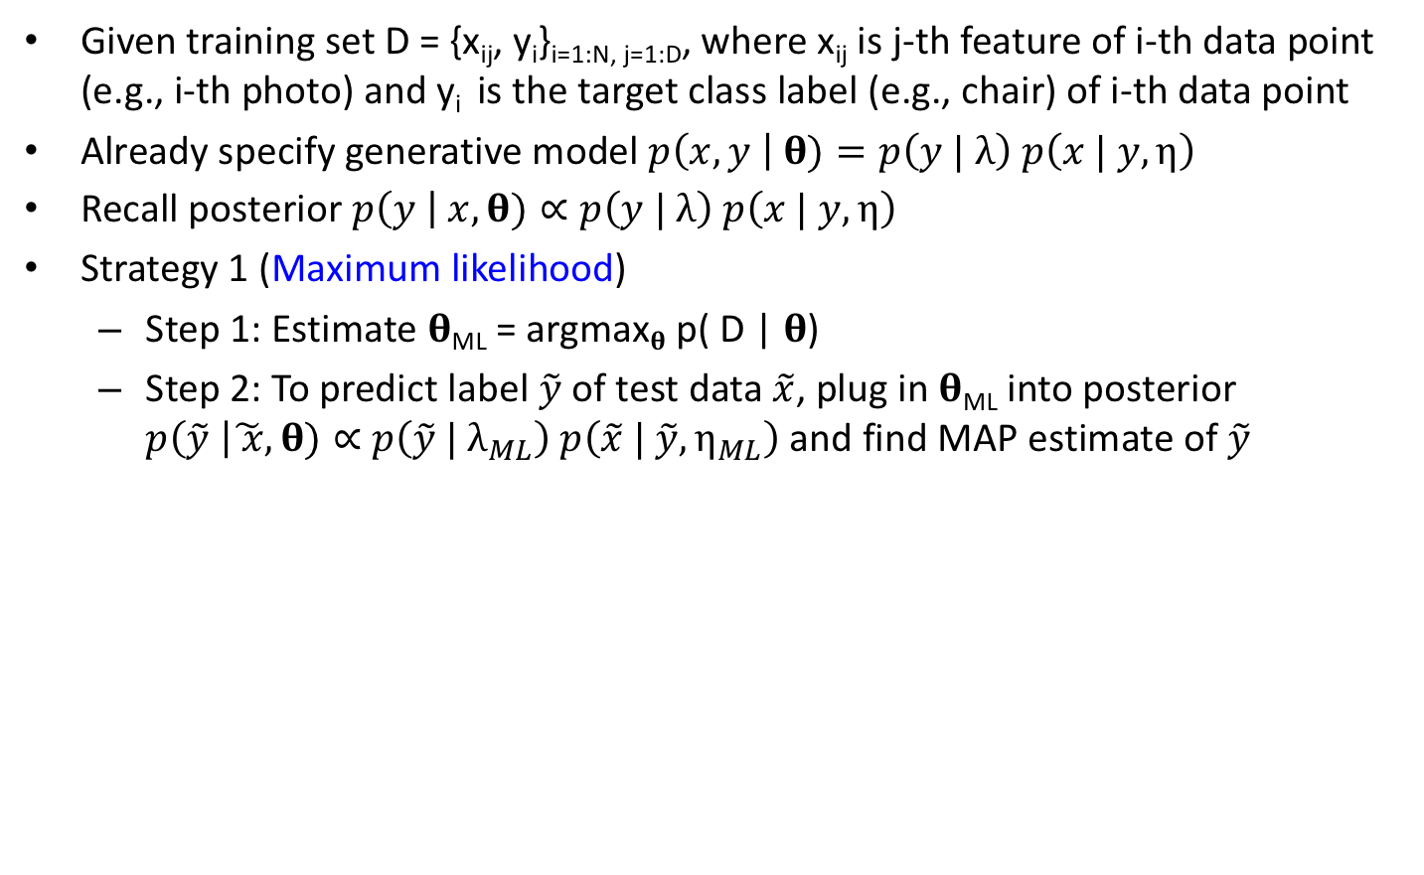
Three Strategies for estimating Naive Bayes Parameters & Classifying New Sample
Given training set D = {x_{ij}, y_{i}}_{i=1:N, j=1:D}, where x_{ij} is j-th feature of i-th data point (e.g., i-th photo) and y_{i} is the target class label (e.g., chair) of i-th data point
Already specify generative model $p\left(x, y \right| \text{θ})=p\left(y | λ\right)$ $p\left(x | y,η\right)$
Recall posterior $p\left(y \right| x,\text{θ})∝p\left(y | λ\right) p\left(x | y,η\right)$
Strategy 1 (Maximum likelihood)
Step 1: Estimate 𝛉_{ML} = argmax_{𝛉} p( D | 𝛉)
Step 2: To predict label $\tilde{y}$ of test data $\tilde{x}$, plug in 𝛉_{ML} into posterior $p\left(\tilde{y} \right|\tilde{ x},\text{θ})∝$ $p\left(\tilde{y} | λ_{ML}\right) p\left(\tilde{x} | \tilde{y},η_{ML}\right)$ and find MAP estimate of $\tilde{y}$
Notes:
To predict the class label $\tilde{y}$ of test feature vector $\tilde{x}$, we can plug in the maximum likelihood estimate of theta into this posterior distribution we just mentioned.
Notice that the two circled equations are the same, except we replace lambda with lambda ML and eta with eta ML.
We can then find the MAP estimate of y tilde.

Slide 78
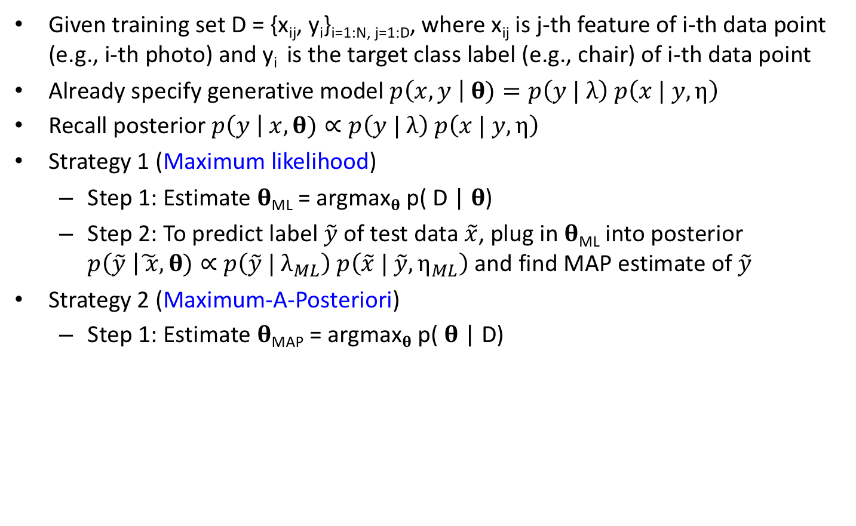
Three Strategies for estimating Naive Bayes Parameters & Classifying New Sample
Given training set D = {x_{ij}, y_{i}}_{i=1:N, j=1:D}, where x_{ij} is j-th feature of i-th data point (e.g., i-th photo) and y_{i} is the target class label (e.g., chair) of i-th data point
Already specify generative model $p\left(x, y \right| \text{θ})=p\left(y | λ\right)$ $p\left(x | y,η\right)$
Recall posterior $p\left(y \right| x,\text{θ})∝p\left(y | λ\right) p\left(x | y,η\right)$
Strategy 1 (Maximum likelihood)
Step 1: Estimate 𝛉_{ML} = argmax_{𝛉} p( D | 𝛉)
Step 2: To predict label $\tilde{y}$ of test data $\tilde{x}$, plug in 𝛉_{ML} into posterior $p\left(\tilde{y} \right|\tilde{ x},\text{θ})∝$ $p\left(\tilde{y} | λ_{ML}\right) p\left(\tilde{x} | \tilde{y},η_{ML}\right)$ and find MAP estimate of $\tilde{y}$
Strategy 2 (Maximum-A-Posteriori)
Step 1: Estimate 𝛉_{MAP} = argmax_{𝛉} p( 𝛉 | D)
Notes:
The second strategy is to perform MAP estimation of theta using the training data.

Slide 79

Three Strategies for estimating Naive Bayes Parameters & Classifying New Sample
Given training set D = {x_{ij}, y_{i}}_{i=1:N, j=1:D}, where x_{ij} is j-th feature of i-th data point (e.g., i-th photo) and y_{i} is the target class label (e.g., chair) of i-th data point
Already specify generative model $p\left(x, y \right| \text{θ})=p\left(y | λ\right)$ $p\left(x | y,η\right)$
Recall posterior $p\left(y \right| x,\text{θ})∝p\left(y | λ\right) p\left(x | y,η\right)$
Strategy 1 (Maximum likelihood)
Step 1: Estimate 𝛉_{ML} = argmax_{𝛉} p( D | 𝛉)
Step 2: To predict label $\tilde{y}$ of test data $\tilde{x}$, plug in 𝛉_{ML} into posterior $p\left(\tilde{y} \right|\tilde{ x},\text{θ})∝$ $p\left(\tilde{y} | λ_{ML}\right) p\left(\tilde{x} | \tilde{y},η_{ML}\right)$ and find MAP estimate of $\tilde{y}$
Strategy 2 (Maximum-A-Posteriori)
Step 1: Estimate 𝛉_{MAP} = argmax_{𝛉} p( 𝛉 | D)
Step 2: To predict label $\tilde{y}$ of test data $\tilde{x}$, plug in 𝛉_{MAP} into posterior $p\left(\tilde{y} \right|\tilde{x},\text{θ})∝p\left(\tilde{y} | λ_{MAP}\right) p\left(\tilde{x} |\tilde{ y},η_{MAP}\right)$ and find MAP estimate of $\tilde{y}$
Notes:
To predict the class label $\tilde{y}$ of test feature vector $\tilde{x}$, we can plug in the MAP estimate of theta into the same posterior distribution as the previous strategy
Notice that the two circled equations are the same, except we replace lambda with lambda MAP and eta with eta MAP.
We can then find the MAP estimate of y tilde.

Slide 80
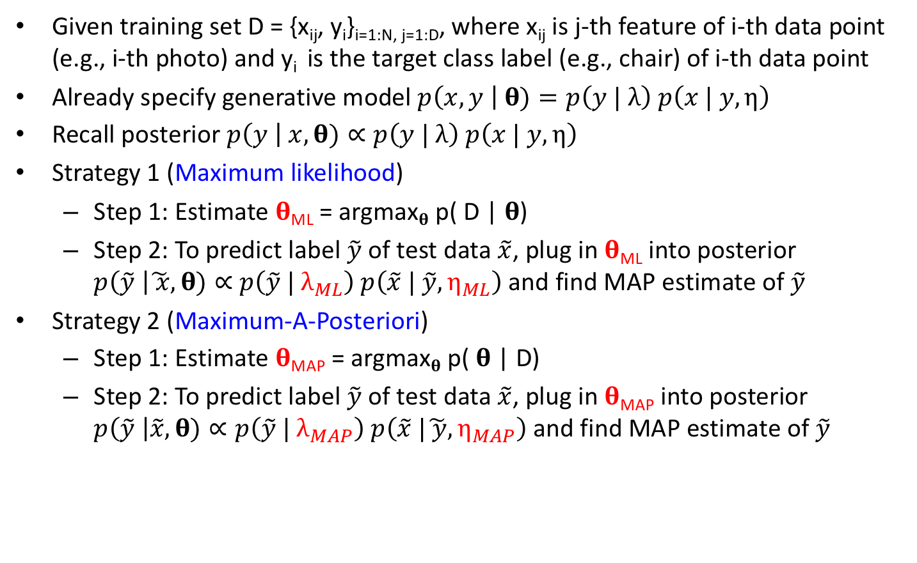
Three Strategies for estimating Naive Bayes Parameters & Classifying New Sample
Given training set D = {x_{ij}, y_{i}}_{i=1:N, j=1:D}, where x_{ij} is j-th feature of i-th data point (e.g., i-th photo) and y_{i} is the target class label (e.g., chair) of i-th data point
Already specify generative model $p\left(x, y \right| \text{θ})=p\left(y | λ\right)$ $p\left(x | y,η\right)$
Recall posterior $p\left(y \right| x,\text{θ})∝p\left(y | λ\right) p\left(x | y,η\right)$
Strategy 1 (Maximum likelihood)
Step 1: Estimate 𝛉_{ML} = argmax_{𝛉} p( D | 𝛉)
Step 2: To predict label $\tilde{y}$ of test data $\tilde{x}$, plug in 𝛉_{ML} into posterior $p\left(\tilde{y} \right|\tilde{ x},\text{θ})∝$ $p\left(\tilde{y} | λ_{ML}\right) p\left(\tilde{x} | \tilde{y},η_{ML}\right)$ and find MAP estimate of $\tilde{y}$
Strategy 2 (Maximum-A-Posteriori)
Step 1: Estimate 𝛉_{MAP} = argmax_{𝛉} p( 𝛉 | D)
Step 2: To predict label $\tilde{y}$ of test data $\tilde{x}$, plug in 𝛉_{MAP} into posterior $p\left(\tilde{y} \right|\tilde{x},\text{θ})∝p\left(\tilde{y} | λ_{MAP}\right) p\left(\tilde{x} |\tilde{ y},η_{MAP}\right)$ and find MAP estimate of $\tilde{y}$
Notes:
So these two strategies are basically the same, except the first strategy uses the maximum likelihood estimates of lambda and eta, while the second strategy uses the MAP estimates of lambda and eta.

Slide 81
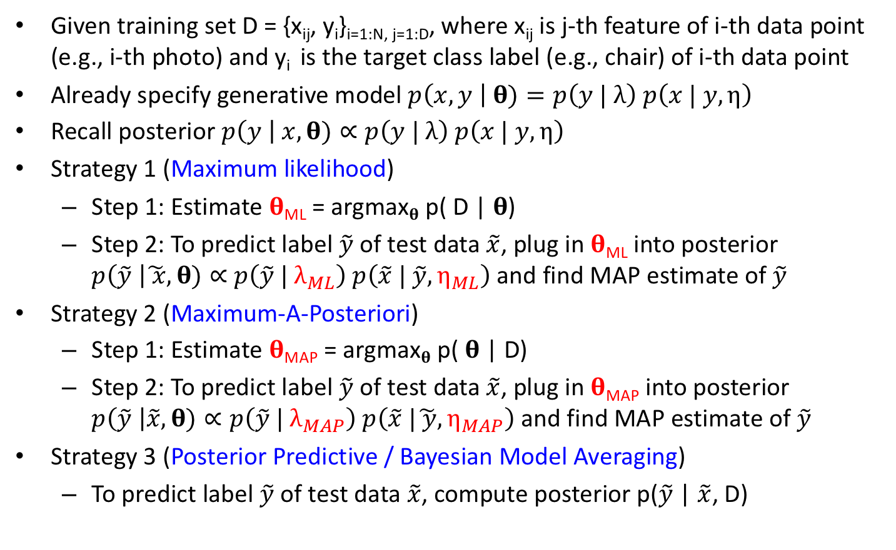
Three Strategies for estimating Naive Bayes Parameters & Classifying New Sample
Given training set D = {x_{ij}, y_{i}}_{i=1:N, j=1:D}, where x_{ij} is j-th feature of i-th data point (e.g., i-th photo) and y_{i} is the target class label (e.g., chair) of i-th data point
Already specify generative model $p\left(x, y \right| \text{θ})=p\left(y | λ\right)$ $p\left(x | y,η\right)$
Recall posterior $p\left(y \right| x,\text{θ})∝p\left(y | λ\right) p\left(x | y,η\right)$
Strategy 1 (Maximum likelihood)
Step 1: Estimate 𝛉_{ML} = argmax_{𝛉} p( D | 𝛉)
Step 2: To predict label $\tilde{y}$ of test data $\tilde{x}$, plug in 𝛉_{ML} into posterior $p\left(\tilde{y} \right|\tilde{ x},\text{θ})∝$ $p\left(\tilde{y} | λ_{ML}\right) p\left(\tilde{x} | \tilde{y},η_{ML}\right)$ and find MAP estimate of $\tilde{y}$
Strategy 2 (Maximum-A-Posteriori)
Step 1: Estimate 𝛉_{MAP} = argmax_{𝛉} p( 𝛉 | D)
Step 2: To predict label $\tilde{y}$ of test data $\tilde{x}$, plug in 𝛉_{MAP} into posterior $p\left(\tilde{y} \right|\tilde{x},\text{θ})∝p\left(\tilde{y} | λ_{MAP}\right) p\left(\tilde{x} |\tilde{ y},η_{MAP}\right)$ and find MAP estimate of $\tilde{y}$
Strategy 3 (Posterior Predictive / Bayesian Model Averaging)
To predict label $\tilde{y}$ of test data $\tilde{x}$, compute posterior p($\tilde{y}$ | $\tilde{x}$, D)
Notes:
The third strategy is posterior predictive, which is also known as bayesian model averaging.
Here we consider a different posterior. For the previous two strategies, we consider the posterior distribution of y tilde GIVEN x tilde and theta.
In the third strategy, the posterior distribution is y tilde GIVEN x tilde and the training data D.

Slide 82
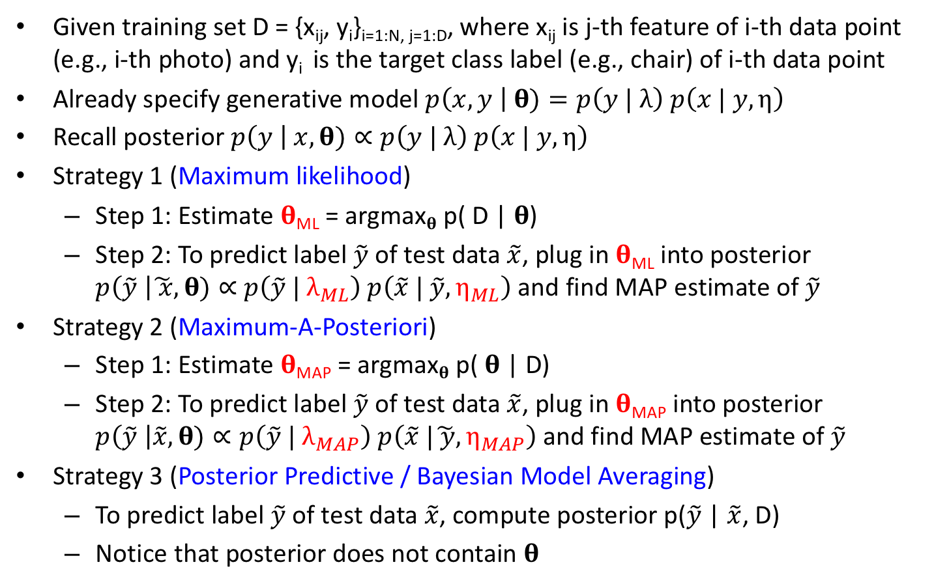
Three Strategies for estimating Naive Bayes Parameters & Classifying New Sample
Given training set D = {x_{ij}, y_{i}}_{i=1:N, j=1:D}, where x_{ij} is j-th feature of i-th data point (e.g., i-th photo) and y_{i} is the target class label (e.g., chair) of i-th data point
Already specify generative model $p\left(x, y \right| \text{θ})=p\left(y | λ\right)$ $p\left(x | y,η\right)$
Recall posterior $p\left(y \right| x,\text{θ})∝p\left(y | λ\right) p\left(x | y,η\right)$
Strategy 1 (Maximum likelihood)
Step 1: Estimate 𝛉_{ML} = argmax_{𝛉} p( D | 𝛉)
Step 2: To predict label $\tilde{y}$ of test data $\tilde{x}$, plug in 𝛉_{ML} into posterior $p\left(\tilde{y} \right|\tilde{ x},\text{θ})∝$ $p\left(\tilde{y} | λ_{ML}\right) p\left(\tilde{x} | \tilde{y},η_{ML}\right)$ and find MAP estimate of $\tilde{y}$
Strategy 2 (Maximum-A-Posteriori)
Step 1: Estimate 𝛉_{MAP} = argmax_{𝛉} p( 𝛉 | D)
Step 2: To predict label $\tilde{y}$ of test data $\tilde{x}$, plug in 𝛉_{MAP} into posterior $p\left(\tilde{y} \right|\tilde{x},\text{θ})∝p\left(\tilde{y} | λ_{MAP}\right) p\left(\tilde{x} |\tilde{ y},η_{MAP}\right)$ and find MAP estimate of $\tilde{y}$
Strategy 3 (Posterior Predictive / Bayesian Model Averaging)
To predict label $\tilde{y}$ of test data $\tilde{x}$, compute posterior p($\tilde{y}$ | $\tilde{x}$, D)
Notice that posterior does not contain 𝛉
Notes:
Therefore in this strategy, the posterior does not contain theta at all.
This is the overview of the three strategies. I will go into them in my details. READY?

Slide 83
Questions?
Notes:
Any questions before I continue?

Slide 84
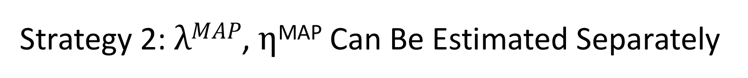
Strategy 2: $λMAP\text{, }η$^{MAP} Can Be Estimated Separately
Notes:
MAP and ML are actually very similar, so let’s start with MAP.
This is from the previous slide. For MAP estimation we want to find the theta that maximizes the posterior distribution p(theta | D).
And theta can be split into lambda and eta, where lambda controls the class prior and eta controls the feature likelihood.
We start by showing that lambda and eta can be estimated separately.

Slide 85
Strategy 2: $λMAP\text{, }η$^{MAP} Can Be Estimated Separately
Notes:
Recall that the training dataset consists of feature x and class label y.
i indexes the data samples. N is the total number of data samples.
For conciseness, x 1:N means that we are considering features x1, x2, to xN.
y 1:N means that we are considering class labels y1, y2, to yN.

Slide 86
Strategy 2: $λMAP\text{, }η$^{MAP} Can Be Estimated Separately
Notes:
We start off with the posterior distribution p of lambda and eta given the training data D.

Slide 87
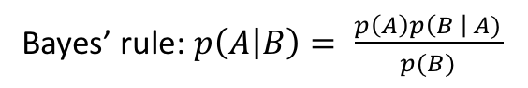
Strategy 2: $λMAP\text{, }η$^{MAP} Can Be Estimated Separately
Bayes’ rule: $p\left(A | B\right)= \frac{p\left(A\right)p\left(B \right| A)}{p(B)}$
Notes:
Let’s apply Bayes rule: p(A | B) is equal to p(A) TIMES p(B|A) divided by p(B).
So in this case, B is equal to D and A is equal to lambda and eta.

Slide 88
Strategy 2: $λMAP\text{, }η$^{MAP} Can Be Estimated Separately
Bayes’ rule: $p\left(A | B\right)= \frac{p\left(A\right)p\left(B \right| A)}{p(B)}$
Plug in D = {x_{1:N}, y_{1:N}}
Notes:
Now we replace D with x1 to xN and y1 to yN.

Slide 89
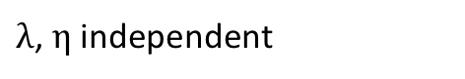
Strategy 2: $λMAP\text{, }η$^{MAP} Can Be Estimated Separately
Bayes’ rule: $p\left(A | B\right)= \frac{p\left(A\right)p\left(B \right| A)}{p(B)}$
Plug in D = {x_{1:N}, y_{1:N}}
$λ\text{, }η$ independent
Notes:
We assume the priors of lambda and eta are independent, so p of lambda and eta becomes p of lambda TIMES p of eta

Slide 90
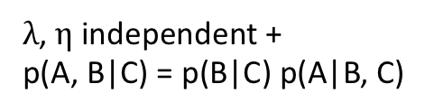
Strategy 2: $λMAP\text{, }η$^{MAP} Can Be Estimated Separately
Bayes’ rule: $p\left(A | B\right)= \frac{p\left(A\right)p\left(B \right| A)}{p(B)}$
Plug in D = {x_{1:N}, y_{1:N}}
$λ\text{, }η$ independent +
p(A, B|C) = p(B|C) p(A|B, C)
Notes:
And then we apply conditional probability p(A, B|C) = p(B|C) p(A|B, C).
If you compare this equation with the circled terms: A is equal to x1 to xN and B is equal to y1 to yN. C is equal to lambda and eta.
Intuitively, this is saying that observing all the x and all the y GIVEN that we have observed lambda and eta. Is the same as first observing the y given lambda and eta, and then observe the x given that we have now observed the y, lambda and eta.

Slide 91
Strategy 2: $λMAP\text{, }η$^{MAP} Can Be Estimated Separately
Bayes’ rule: $p\left(A | B\right)= \frac{p\left(A\right)p\left(B \right| A)}{p(B)}$
Plug in D = {x_{1:N}, y_{1:N}}
$λ\text{, }η$ independent +
p(A, B|C) = p(B|C) p(A|B, C)
Notes:
The denominator is also basic conditional probability.
Probability of observing all the x and all the y is the same as first observing the y, then observe x given that we have observed y.

Slide 92
Strategy 2: $λMAP\text{, }η$^{MAP} Can Be Estimated Separately
Bayes’ rule: $p\left(A | B\right)= \frac{p\left(A\right)p\left(B \right| A)}{p(B)}$
Plug in D = {x_{1:N}, y_{1:N}}
$λ\text{, }η$ independent +
p(A, B|C) = p(B|C) p(A|B, C)
Apply conditional
independence relations
Notes:
Now we apply the conditional independence assumptions.
Remember that lambda governs the class prior term? So y does not depend on eta at all and we can drop eta.

Slide 93
Strategy 2: $λMAP\text{, }η$^{MAP} Can Be Estimated Separately
Bayes’ rule: $p\left(A | B\right)= \frac{p\left(A\right)p\left(B \right| A)}{p(B)}$
Plug in D = {x_{1:N}, y_{1:N}}
$λ\text{, }η$ independent +
p(A, B|C) = p(B|C) p(A|B, C)
Apply conditional
independence relations
Notes:
Similarly, eta governs the feature likelihood distribution, so conditioned on knowing the class labels y, x and lambda are independent, so we can drop lambda

Slide 94
Strategy 2: $λMAP\text{, }η$^{MAP} Can Be Estimated Separately
Bayes’ rule: $p\left(A | B\right)= \frac{p\left(A\right)p\left(B \right| A)}{p(B)}$
Plug in D = {x_{1:N}, y_{1:N}}
$λ\text{, }η$ independent +
p(A, B|C) = p(B|C) p(A|B, C)
Apply conditional
independence relations
Re-grouping
Terms
Notes:
Now we re-group the terms. In particular, we take the 3 terms on top and put it into the first bracket.

Slide 95
Strategy 2: $λMAP\text{, }η$^{MAP} Can Be Estimated Separately
Bayes’ rule: $p\left(A | B\right)= \frac{p\left(A\right)p\left(B \right| A)}{p(B)}$
Plug in D = {x_{1:N}, y_{1:N}}
$λ\text{, }η$ independent +
p(A, B|C) = p(B|C) p(A|B, C)
Apply conditional
independence relations
Re-grouping
Terms
Notes:
And then we take the remaining three terms and group them into the second bracket.

Slide 96
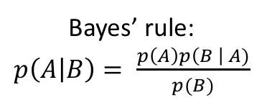
Strategy 2: $λMAP\text{, }η$^{MAP} Can Be Estimated Separately
Bayes’ rule: $p\left(A | B\right)= \frac{p\left(A\right)p\left(B \right| A)}{p(B)}$
Plug in D = {x_{1:N}, y_{1:N}}
$λ\text{, }η$ independent +
p(A, B|C) = p(B|C) p(A|B, C)
Apply conditional
independence relations
Re-grouping
Terms
Bayes’ rule:
Notes:
Now, we can apply bayes’ rule to the first term so we end up with posterior distribution of lambda given all the class labels y1 to yN.

Slide 97
Strategy 2: $λMAP\text{, }η$^{MAP} Can Be Estimated Separately
Bayes’ rule: $p\left(A | B\right)= \frac{p\left(A\right)p\left(B \right| A)}{p(B)}$
Plug in D = {x_{1:N}, y_{1:N}}
$λ\text{, }η$ independent +
p(A, B|C) = p(B|C) p(A|B, C)
Apply conditional
independence relations
Re-grouping
Terms
Bayes’ rule:
Notes:
The lambda appears in the first term and eta appears in the second term.
So we can optimize lambda and eta separately.

Slide 98
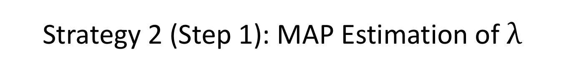
Strategy 2 (Step 1): MAP Estimation of$λ$
Notes:
Now, let’s optimize lambda with respect to the posterior distribution p of lambda GIVEN all the class labels y.
This formula is the first term from the previous page.

Slide 99
Strategy 2 (Step 1): MAP Estimation of$λ$
Notes:
Actually we have solved this problem in our previous class.
Suppose there are only 2 classes, so let’s think of class 1 as tail and class 2 as head. Then lambda is the probability of getting a head.
If we assume a beta prior with hyperparameters a and b, then the MAP estimate of lambda is given by this equation, which is the same as the previous class.
Nhead is the number of data samples in class 2.

Slide 100
Strategy 2 (Step 1): MAP Estimation of$λ$
Notes:
Similarly, if we are classifying more than 2 classes, then if we assume the dirichlet prior, the MAP estimate can also be copied from the previous class.
Any questions?

Slide 101
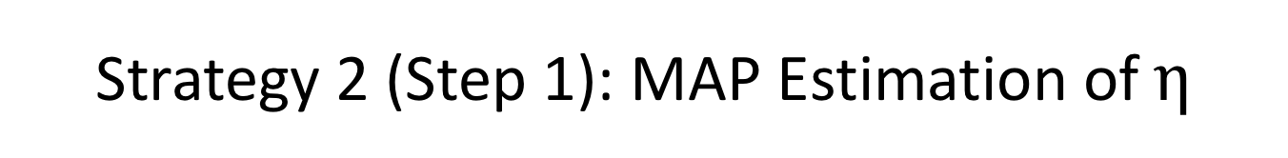
Strategy 2 (Step 1): MAP Estimation of $η$
Notes:
Now let’s estimate eta, which are the parameters of the feature likelihood term.
This equation here is the second term from two slides ago.
The MAP estimate of eta comes from optimizing this term.

Slide 102
Strategy 2 (Step 1): MAP Estimation of $η$
Notes:
Remember there is an eta for every feature dimension j and every class c.
The key is to observe that eta jc can be optimized for each dimension j and each class c separately.
In particular, we can break up the term into

Slide 103
Strategy 2 (Step 1): MAP Estimation of $η$
Each dimension j is independent because of naïve Bayes
Notes:
product from j = 1 to D, where D is the number of feature dimensions. The reason is because Naïve bayes assume the features are independent conditioned on the class labels y

Slide 104
Strategy 2 (Step 1): MAP Estimation of $η$
Each dimension j is independent because of naïve Bayes
Knowing what chairs look like do not tell us what cows look like, so features from chair and cow photos are independent
Notes:
And product from c = 1 to capital C, where C is the number number of classes. This is because Knowing what chairs look like do not tell us what cows look like, so features from chair and cow photos are independent.
So in other words, once we are given class labels y, then the all the photos from different classes are independent.

Slide 105
Strategy 2 (Step 1): MAP Estimation of $η$
Each dimension j is independent because of naïve Bayes
Knowing what chairs look like do not tell us what cows look like, so features from chair and cow photos are independent
Priors for dimension j and class c are independent
Notes:
p of eta jc because we assume the priors on eta are independent for each dimension and each class c.

Slide 106
Strategy 2 (Step 1): MAP Estimation of $η$
Each dimension j is independent because of naïve Bayes
Knowing what chairs look like do not tell us what cows look like, so features from chair and cow photos are independent
Priors for dimension j and class c are independent
Notes:
On the left is the probability distribution of features x1 to xN given all class labels y and eta.
As I explained, we can consider photographs of cows and chairs separately. So for a particular class c, we simply collect the features x of all datapoints belonging to class c. That’s what the i belongs to c means.
And remember the features are independent, so we can consider each feature dimension j separately.
And then since we are only consider class c and dimension j, eta becomes eta j c.

Slide 107
Strategy 2 (Step 1): MAP Estimation of $η$
Each dimension j is independent because of naïve Bayes
Knowing what chairs look like do not tell us what cows look like, so features from chair and cow photos are independent
Priors for dimension j and class c are independent
Notes:
The same thing can be applied to the denominator.

Slide 108
Strategy 2 (Step 1): MAP Estimation of $η$
Each dimension j is independent because of naïve Bayes
Knowing what chairs look like do not tell us what cows look like, so features from chair and cow photos are independent
Priors for dimension j and class c are independent
Bayes’ rule
Notes:
Now we can apply Bayes’ rule and we get the posterior distribution of eta for dimension j and class c GIVEN the j-th feature of all datapoints belonging to class c.

Slide 109
Strategy 2 (Step 1): MAP Estimation of $η$
Each dimension j is independent because of naïve Bayes
Knowing what chairs look like do not tell us what cows look like, so features from chair and cow photos are independent
Priors for dimension j and class c are independent
Bayes’ rule
Notes:
Therefore, for every dimension j and every class c, we perform MAP estimation of eta jc. Using posterior distribution eta jc GIVEN the j-th feature of all datapoints belonging to class c.

Slide 110
Strategy 2 (Step 1): MAP Estimation of $η$
Each dimension j is independent because of naïve Bayes
Knowing what chairs look like do not tell us what cows look like, so features from chair and cow photos are independent
Priors for dimension j and class c are independent
Bayes’ rule
Notes:
For example, suppose feature 1 is Gaussian, then eta12 consists of the mean and variance of the 1st feature of the second class.
To perform MAP estimation, we can apply the univarate Gaussian MAP lecture notes from the beginning of this class to the first feature of all data samples coming from class 2.

Slide 111
Strategy 2 (Step 1): MAP Estimation of $η$
Each dimension j is independent because of naïve Bayes
Knowing what chairs look like do not tell us what cows look like, so features from chair and cow photos are independent
Priors for dimension j and class c are independent
Bayes’ rule
Notes:
Now, suppose feature 2 is binary, so we have a bernoulli distribution. Then eta 23 is the probability of getting a head for the second feature of the third class.
To perform MAP estimation, we can apply the beta-binomial MAP lecture notes to the second feature of all data samples coming from class 3.
Any questions?

Slide 112
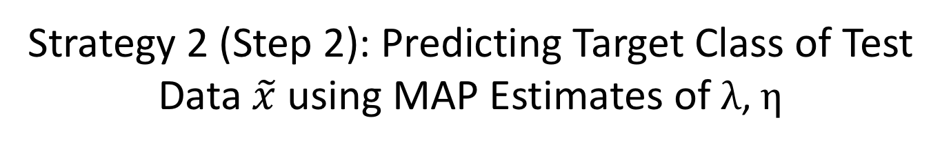
Strategy 2 (Step 2): Predicting Target Class of Test Data $\tilde{x}$ using MAP Estimates of $λ\text{, }η$
Notes:
Ok! Now we have the MAP estimates of lambda and eta, given a new data sample x tilde, we want to predict the class label y tilde.
So let’s consider the posterior distribution p of label label y tilde = class c given feature x tilde and the MAP estimates of lambda and eta.

Slide 113
Strategy 2 (Step 2): Predicting Target Class of Test Data $\tilde{x}$ using MAP Estimates of $λ\text{, }η$
Recall posterior can be split into class prior & feature likelihood
Notes:
Recall that this posterior distribution is proportional to the class prior p of ytilde equal to class c GIVEN the MAP estimate of lambda TIMES the feature likelihood p of feature xtilde GIVEN ytilde equal to class c and MAP estimate of eta

Slide 114
Strategy 2 (Step 2): Predicting Target Class of Test Data $\tilde{x}$ using MAP Estimates of $λ\text{, }η$
Recall posterior can be split into class prior & feature likelihood
Naïve Bayes Assumption
Notes:
The prior probability of getting class c is simply lambda MAP c, which is the probability of getting side c of the dice.

Slide 115
Strategy 2 (Step 2): Predicting Target Class of Test Data $\tilde{x}$ using MAP Estimates of $λ\text{, }η$
Recall posterior can be split into class prior & feature likelihood
Naïve Bayes Assumption
Notes:
The second term can be decomposed into a product over feature dimension j because naïve bayes assumes the feature dimensions are independent given the class label,
Any questions?

Slide 116
Strategy 2 (Step 2): Predicting Target Class of Test Data $\tilde{x}$ using MAP Estimates of $λ\text{, }η$
Recall posterior can be split into class prior & feature likelihood
Naïve Bayes Assumption
Notes:
We evaluate the above equation for different c, and then the MAP estimate of y tilde is the posterior with the highest probability.

Slide 117
Strategy 2 (Step 2): Predicting Target Class of Test Data $\tilde{x}$ using MAP Estimates of $λ\text{, }η$
Recall posterior can be split into class prior & feature likelihood
Naïve Bayes Assumption
Notes:
In practice, for numerical stability, we compute the log of the above expression.

Slide 118
Strategy 2 (Step 2): Predicting Target Class of Test Data $\tilde{x}$ using MAP Estimates of $λ\text{, }η$
Recall posterior can be split into class prior & feature likelihood
Naïve Bayes Assumption
log ab = log a + log b
Notes:
Since log of a TIMES b is equal to log of a + log of b, therefore, the term becomes log MAP estimate of lambda c + sum from j = 1 to D log p of the j feature of x tilde GIVEN the MAP estimate of eta jc.

Slide 119
Strategy 2 (Step 2): Predicting Target Class of Test Data $\tilde{x}$ using MAP Estimates of $λ\text{, }η$
Recall posterior can be split into class prior & feature likelihood
Naïve Bayes Assumption
log ab = log a + log b
Notes:
To use strategy 1, we can simply replace the MAP estimates of lambda and eta with the maximum likelihood estimate of lambda and eta.
Any questions?

Slide 120
Questions?
Notes:
Any questions before I continue with strategy 3?

Slide 121
Naïve Bayes Example
Notes:
Any questions before I show you an example?

Slide 122
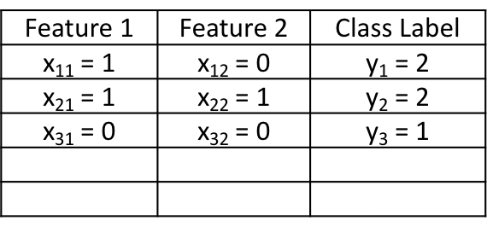
Feature 1 | Feature 2 | Class Label
x₁₁ = 1 | x₁₂ = 0 | y₁ = 2
x₂₁ = 1 | x₂₂ = 1 | y₂ = 2
x₃₁ = 0 | x₃₂ = 0 | y₃ = 1
$\tilde{x}\text{1}$ = 1 | $\tilde{x}$₂ = 0 | $\tilde{y}$ = ?
Class 2 = head, Class 1 = tail
Training
Data
Notes:
Suppose the training data consists of three samples.
Each row corresponds to one training sample.

Slide 123
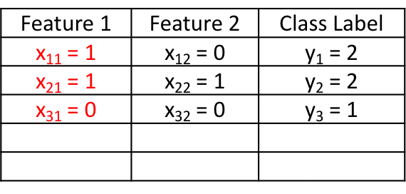
Feature 1 | Feature 2 | Class Label
x₁₁ = 1 | x₁₂ = 0 | y₁ = 2
x₂₁ = 1 | x₂₂ = 1 | y₂ = 2
x₃₁ = 0 | x₃₂ = 0 | y₃ = 1
$\tilde{x}\text{1}$ = 1 | $\tilde{x}$₂ = 0 | $\tilde{y}$ = ?
Class 2 = head, Class 1 = tail
Training
Data
Notes:
The first column is feature 1. You can see that the first feature is equal to 1 for the first two samples and equal to 0 for the third sample.

Slide 124
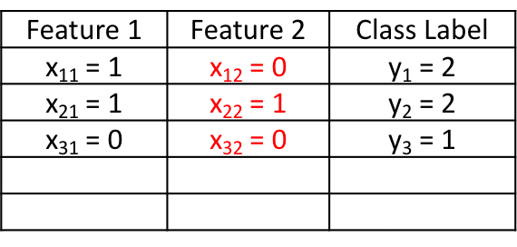
Feature 1 | Feature 2 | Class Label
x₁₁ = 1 | x₁₂ = 0 | y₁ = 2
x₂₁ = 1 | x₂₂ = 1 | y₂ = 2
x₃₁ = 0 | x₃₂ = 0 | y₃ = 1
$\tilde{x}\text{1}$ = 1 | $\tilde{x}$₂ = 0 | $\tilde{y}$ = ?
Class 2 = head, Class 1 = tail
Training
Data
Notes:
The second column is feature 2. You can see that the second feature is equal to 0 for the first and third sample, and is equal to 1 for the second sample.

Slide 125
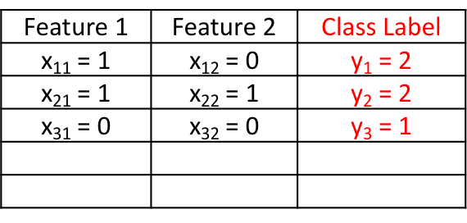
Feature 1 | Feature 2 | Class Label
x₁₁ = 1 | x₁₂ = 0 | y₁ = 2
x₂₁ = 1 | x₂₂ = 1 | y₂ = 2
x₃₁ = 0 | x₃₂ = 0 | y₃ = 1
$\tilde{x}\text{1}$ = 1 | $\tilde{x}$₂ = 0 | $\tilde{y}$ = ?
Class 2 = head, Class 1 = tail
Training
Data
Notes:
The third column is class label y. First two samples are from class 2, third sample is from class 1.
For convenience, let’s think of class 2 as head and class 1 as tail.

Slide 126
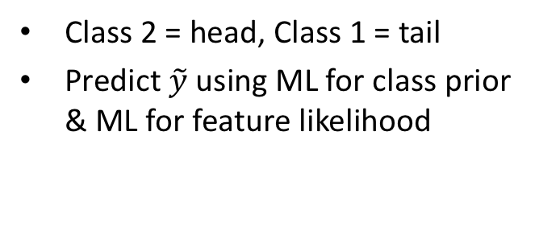
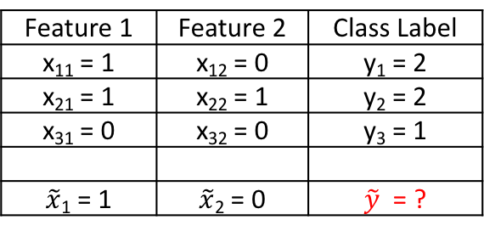
Feature 1 | Feature 2 | Class Label
x₁₁ = 1 | x₁₂ = 0 | y₁ = 2
x₂₁ = 1 | x₂₂ = 1 | y₂ = 2
x₃₁ = 0 | x₃₂ = 0 | y₃ = 1
$\tilde{x}\text{1}$ = 1 | $\tilde{x}$₂ = 0 | $\tilde{y}$ = ?
Class 2 = head, Class 1 = tail
Predict $\tilde{y}$using ML for class prior & ML for feature likelihood
Training
Data
Test Data
Notes:
Now, let’s consider test sample x tilde. xtilde1 is 1, xtilde2 is 2. We want to predict y tilde.
We will use maximum likelihood estimation for the class prior parameters and for the feature likelihood
Everyone ok with the problem set up??

Slide 127
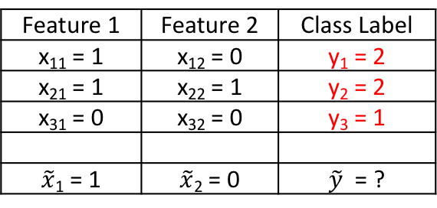
Feature 1 | Feature 2 | Class Label
x₁₁ = 1 | x₁₂ = 0 | y₁ = 2
x₂₁ = 1 | x₂₂ = 1 | y₂ = 2
x₃₁ = 0 | x₃₂ = 0 | y₃ = 1
$\tilde{x}\text{1}$ = 1 | $\tilde{x}$₂ = 0 | $\tilde{y}$ = ?
Class 2 = head, Class 1 = tail
Predict $\tilde{y}$using ML for class prior & ML for feature likelihood
Training
Data
Test Data
Notes:
Ok! First thing is that the maximum likelihood estimate of the class prior lambda is 2/3 because 2 of the 3 training examples are from class 2.

Slide 128

Feature 1 | Feature 2 | Class Label
x₁₁ = 1 | x₁₂ = 0 | y₁ = 2
x₂₁ = 1 | x₂₂ = 1 | y₂ = 2
x₃₁ = 0 | x₃₂ = 0 | y₃ = 1
$\tilde{x}\text{1}$ = 1 | $\tilde{x}$₂ = 0 | $\tilde{y}$ = ?
Class 2 = head, Class 1 = tail
Predict $\tilde{y}$using ML for class prior & ML for feature likelihood
Training
Data
Test Data
Notes:
Let’s compute the log posterior p of y tilde equal to class 1 GIVEN x tilde and training set D.

Slide 129

Feature 1 | Feature 2 | Class Label
x₁₁ = 1 | x₁₂ = 0 | y₁ = 2
x₂₁ = 1 | x₂₂ = 1 | y₂ = 2
x₃₁ = 0 | x₃₂ = 0 | y₃ = 1
$\tilde{x}\text{1}$ = 1 | $\tilde{x}$₂ = 0 | $\tilde{y}$ = ?
Class 2 = head, Class 1 = tail
Predict $\tilde{y}$using ML for class prior & ML for feature likelihood
Training
Data
Test Data
Formula from
previous slide: c = 1
Notes:
This is the formula from the previous slide.
The first term is the class prior, which the question asks to use the ML estimate.
The second term is the feature likelihood.

Slide 130
Feature 1 | Feature 2 | Class Label
x₁₁ = 1 | x₁₂ = 0 | y₁ = 2
x₂₁ = 1 | x₂₂ = 1 | y₂ = 2
x₃₁ = 0 | x₃₂ = 0 | y₃ = 1
$\tilde{x}\text{1}$ = 1 | $\tilde{x}$₂ = 0 | $\tilde{y}$ = ?
Class 2 = head, Class 1 = tail
Predict $\tilde{y}$using ML for class prior & ML for feature likelihood
Training
Data
Test Data
Formula from
previous slide: c = 1
Notes:
Let’s consider the first term. Remember class 1 is tail. And lambda is the probability of getting a head.
So we get 1 – MINUS Lambda ML.
Any question?

Slide 131
Feature 1 | Feature 2 | Class Label
x₁₁ = 1 | x₁₂ = 0 | y₁ = 2
x₂₁ = 1 | x₂₂ = 1 | y₂ = 2
x₃₁ = 0 | x₃₂ = 0 | y₃ = 1
$\tilde{x}\text{1}$ = 1 | $\tilde{x}$₂ = 0 | $\tilde{y}$ = ?
Class 2 = head, Class 1 = tail
Predict $\tilde{y}$using ML for class prior & ML for feature likelihood
Training
Data
Test Data
Formula from
previous slide: c = 1
Notes:
These two terms come from expanding the sum.
So the first term corresponds to the first feature dimension j = 1
The second term corresponds to the second feature dimension j = 2

Slide 132

Feature 1 | Feature 2 | Class Label
x₁₁ = 1 | x₁₂ = 0 | y₁ = 2
x₂₁ = 1 | x₂₂ = 1 | y₂ = 2
x₃₁ = 0 | x₃₂ = 0 | y₃ = 1
$\tilde{x}\text{1}$ = 1 | $\tilde{x}$₂ = 0 | $\tilde{y}$ = ?
Class 2 = head, Class 1 = tail
Predict $\tilde{y}$using ML for class prior & ML for feature likelihood
Training
Data
Test Data
Formula from
previous slide: c = 1
Notes:
Also note that x tilde 1 is 1 and x tilde 2 is 0.

Slide 133
Feature 1 | Feature 2 | Class Label
x₁₁ = 1 | x₁₂ = 0 | y₁ = 2
x₂₁ = 1 | x₂₂ = 1 | y₂ = 2
x₃₁ = 0 | x₃₂ = 0 | y₃ = 1
$\tilde{x}\text{1}$ = 1 | $\tilde{x}$₂ = 0 | $\tilde{y}$ = ?
Class 2 = head, Class 1 = tail
Predict $\tilde{y}$using ML for class prior & ML for feature likelihood
Training
Data
Test Data
Formula from
previous slide: c = 1
Notes:
Now, let’s plug in the numbers.
Lambda ML is 2/3. So 1 minus 2/3 is 1/3.

Slide 134

Feature 1 | Feature 2 | Class Label
x₁₁ = 1 | x₁₂ = 0 | y₁ = 2
x₂₁ = 1 | x₂₂ = 1 | y₂ = 2
x₃₁ = 0 | x₃₂ = 0 | y₃ = 1
$\tilde{x}\text{1}$ = 1 | $\tilde{x}$₂ = 0 | $\tilde{y}$ = ?
Class 2 = head, Class 1 = tail
Predict $\tilde{y}$using ML for class prior & ML for feature likelihood
Training
Data
Test Data
Formula from
previous slide: c = 1
Last lecture: ML estimate of probability of head $\text{= }\frac{N1}{N}$ , where N₁ = # heads & N = # coin tosses
Class 1, feature 1: N = 1 (since class 1 appears once), N₁ = 0 (since among class 1 training data, feature 1 is always 0), so $η_{11}^{ML}=$ $\frac{0}{1}=0$
Class 1, feature 2: N = 1 (since class 1 appears once), N₁ = 0 (since among class 1 training data, feature 2 is always 0), so $η_{21}^{ML}=$ $\frac{0}{1}=0$
Notes:
Now consider the second term.
First I want to remind you that from the previous lecture on beta-binomial distribution, the ML estimate of the probability of getting head is just N1 divided by N, where N1 is the number of heads and N is the number of coin tosses.

Slide 135

Feature 1 | Feature 2 | Class Label
x₁₁ = 1 | x₁₂ = 0 | y₁ = 2
x₂₁ = 1 | x₂₂ = 1 | y₂ = 2
x₃₁ = 0 | x₃₂ = 0 | y₃ = 1
$\tilde{x}\text{1}$ = 1 | $\tilde{x}$₂ = 0 | $\tilde{y}$ = ?
Class 2 = head, Class 1 = tail
Predict $\tilde{y}$using ML for class prior & ML for feature likelihood
Training
Data
Test Data
Formula from
previous slide: c = 1
Last lecture: ML estimate of probability of head $\text{= }\frac{N1}{N}$ , where N₁ = # heads & N = # coin tosses
Class 1, feature 1: N = 1 (since class 1 appears once), N₁ = 0 (since among class 1 training data, feature 1 is always 0), so $η_{11}^{ML}=$ $\frac{0}{1}=0$
Class 1, feature 2: N = 1 (since class 1 appears once), N₁ = 0 (since among class 1 training data, feature 2 is always 0), so $η_{21}^{ML}=$ $\frac{0}{1}=0$
Notes:
Just to remind you that eta 11 is the probability of getting a head for the first feature in class 1.

Slide 136


Feature 1 | Feature 2 | Class Label
x₁₁ = 1 | x₁₂ = 0 | y₁ = 2
x₂₁ = 1 | x₂₂ = 1 | y₂ = 2
x₃₁ = 0 | x₃₂ = 0 | y₃ = 1
$\tilde{x}\text{1}$ = 1 | $\tilde{x}$₂ = 0 | $\tilde{y}$ = ?
Class 2 = head, Class 1 = tail
Predict $\tilde{y}$using ML for class prior & ML for feature likelihood
Training
Data
Test Data
Formula from
previous slide: c = 1
Last lecture: ML estimate of probability of head $\text{= }\frac{N1}{N}$ , where N₁ = # heads & N = # coin tosses
Class 1, feature 1: N = 1 (since class 1 appears once), N₁ = 0 (since among class 1 training data, feature 1 is always 0), so $η_{11}^{ML}=$ $\frac{0}{1}=0$
Class 1, feature 2: N = 1 (since class 1 appears once), N₁ = 0 (since among class 1 training data, feature 2 is always 0), so $η_{21}^{ML}=$ $\frac{0}{1}=0$
Notes:
So we consider all the training examples from class 1 and looking at their first feature, which I have highlighted in green.
There is only one training example from class 1, so N is equal to 1.
N1 is equal to 0 since among all class 1 training data, feature 1 is always 0.

Slide 137

Feature 1 | Feature 2 | Class Label
x₁₁ = 1 | x₁₂ = 0 | y₁ = 2
x₂₁ = 1 | x₂₂ = 1 | y₂ = 2
x₃₁ = 0 | x₃₂ = 0 | y₃ = 1
$\tilde{x}\text{1}$ = 1 | $\tilde{x}$₂ = 0 | $\tilde{y}$ = ?
Class 2 = head, Class 1 = tail
Predict $\tilde{y}$using ML for class prior & ML for feature likelihood
Training
Data
Test Data
Formula from
previous slide: c = 1
Last lecture: ML estimate of probability of head $\text{= }\frac{N1}{N}$ , where N₁ = # heads & N = # coin tosses
Class 1, feature 1: N = 1 (since class 1 appears once), N₁ = 0 (since among class 1 training data, feature 1 is always 0), so $η_{11}^{ML}=$ $\frac{0}{1}=0$
Class 1, feature 2: N = 1 (since class 1 appears once), N₁ = 0 (since among class 1 training data, feature 2 is always 0), so $η_{21}^{ML}=$ $\frac{0}{1}=0$
Notes:
So eta ML 11 is equal to 0 divided by 1 should is 0.
And so this probability in the second term is 0.

Slide 138
Feature 1 | Feature 2 | Class Label
x₁₁ = 1 | x₁₂ = 0 | y₁ = 2
x₂₁ = 1 | x₂₂ = 1 | y₂ = 2
x₃₁ = 0 | x₃₂ = 0 | y₃ = 1
$\tilde{x}\text{1}$ = 1 | $\tilde{x}$₂ = 0 | $\tilde{y}$ = ?
Class 2 = head, Class 1 = tail
Predict $\tilde{y}$using ML for class prior & ML for feature likelihood
Training
Data
Test Data
Formula from
previous slide: c = 1
Last lecture: ML estimate of probability of head $\text{= }\frac{N1}{N}$ , where N₁ = # heads & N = # coin tosses
Class 1, feature 1: N = 1 (since class 1 appears once), N₁ = 0 (since among class 1 training data, feature 1 is always 0), so $η_{11}^{ML}=$ $\frac{0}{1}=0$
Class 1, feature 2: N = 1 (since class 1 appears once), N₁ = 0 (since among class 1 training data, feature 2 is always 0), so $η_{21}^{ML}=$ $\frac{0}{1}=0$
Notes:
Now, let’s think about what the third term is saying. This is the probability that the second feature of x tilde is 0 given that class y tilde is equal to 1.

Slide 139


Feature 1 | Feature 2 | Class Label
x₁₁ = 1 | x₁₂ = 0 | y₁ = 2
x₂₁ = 1 | x₂₂ = 1 | y₂ = 2
x₃₁ = 0 | x₃₂ = 0 | y₃ = 1
$\tilde{x}\text{1}$ = 1 | $\tilde{x}$₂ = 0 | $\tilde{y}$ = ?
Class 2 = head, Class 1 = tail
Predict $\tilde{y}$using ML for class prior & ML for feature likelihood
Training
Data
Test Data
Formula from
previous slide: c = 1
Last lecture: ML estimate of probability of head $\text{= }\frac{N1}{N}$ , where N₁ = # heads & N = # coin tosses
Class 1, feature 1: N = 1 (since class 1 appears once), N₁ = 0 (since among class 1 training data, feature 1 is always 0), so $η_{11}^{ML}=$ $\frac{0}{1}=0$
Class 1, feature 2: N = 1 (since class 1 appears once), N₁ = 0 (since among class 1 training data, feature 2 is always 0), so $η_{21}^{ML}=$ $\frac{0}{1}=0$
Notes:
So we consider all the training examples from class 1 and looking at their second feature, which I have highlighted in red.
There is only one training example from class 1, so N is equal to 1.
N1 is equal to 0 since among all class 1 training data, feature 1 is always 0.

Slide 140

Feature 1 | Feature 2 | Class Label
x₁₁ = 1 | x₁₂ = 0 | y₁ = 2
x₂₁ = 1 | x₂₂ = 1 | y₂ = 2
x₃₁ = 0 | x₃₂ = 0 | y₃ = 1
$\tilde{x}\text{1}$ = 1 | $\tilde{x}$₂ = 0 | $\tilde{y}$ = ?
Class 2 = head, Class 1 = tail
Predict $\tilde{y}$using ML for class prior & ML for feature likelihood
Training
Data
Test Data
Formula from
previous slide: c = 1
Last lecture: ML estimate of probability of head $\text{= }\frac{N1}{N}$ , where N₁ = # heads & N = # coin tosses
Class 1, feature 1: N = 1 (since class 1 appears once), N₁ = 0 (since among class 1 training data, feature 1 is always 0), so $η_{11}^{ML}=$ $\frac{0}{1}=0$
Class 1, feature 2: N = 1 (since class 1 appears once), N₁ = 0 (since among class 1 training data, feature 2 is always 0), so $η_{21}^{ML}=$ $\frac{0}{1}=0$
Notes:
The the ML estimate for eta 21 is 0 divided by 1 should is 0.
And so the third probability is 1 – 0.
And so our final answer is –infinity.

Slide 141


Feature 1 | Feature 2 | Class Label
x₁₁ = 1 | x₁₂ = 0 | y₁ = 2
x₂₁ = 1 | x₂₂ = 1 | y₂ = 2
x₃₁ = 0 | x₃₂ = 0 | y₃ = 1
$\tilde{x}\text{1}$ = 1 | $\tilde{x}$₂ = 0 | $\tilde{y}$ = ?
Class 2 = head, Class 1 = tail
Predict $\tilde{y}$using ML for class prior & ML for feature likelihood
Training
Data
Test Data
Formula from
previous slide: c = 2
Last lecture: ML estimate of probability of head $\text{= }\frac{N1}{N}$ , where N₁ = # heads & N = # coin tosses
Class 2, feature 1: N = 2 (since class 2 appears twice), N₁ = 2 (since among class 2 training data, feature 1 is 1 twice), so $η_{12}^{ML}=$ $\frac{2}{2}=1$
Class 2, feature 2: N = 2 (since class 2 appears twice), N₁ = 1 (since among class 2 training data, feature 2 is 1 once), so $η_{22}^{ML}=$ $\frac{1}{2}=1/2$
Notes:
We can repeat this for class 2. And we get -1.10

Slide 142
Feature 1 | Feature 2 | Class Label
x₁₁ = 1 | x₁₂ = 0 | y₁ = 2
x₂₁ = 1 | x₂₂ = 1 | y₂ = 2
x₃₁ = 0 | x₃₂ = 0 | y₃ = 1
$\tilde{x}\text{1}$ = 1 | $\tilde{x}$₂ = 0 | $\tilde{y}$ = ?
Class 2 = head, Class 1 = tail
Predict $\tilde{y}$using ML for class prior & ML for feature likelihood
Training
Data
Test Data
Notes:
To summarize, we have evaluated the log posterior of y tilde equal to class 1 to be -infinity
And the log posterior of y tilde equal to class 2 is -1.10
Since -1.1 is bigger than -inf, therefore we predict y tilde is equal to class 2.
<PAUSE>
The fact that one of the log probability is –infinity suggests that ML might be overfitting. Because this says that we are 100% sure x tilde is not from class 1. But we only have 3 data samples! How can we be 100% sure of anything? This motivates the use of posterior predictive approach.

Slide 143
Questions?
Notes:
Any questions before I continue with strategy 3?

Slide 144
Strategy 3: Posterior Predictive
Notes:
Ok. Once again, recall that the training dataset D consists of features x1, x2, to xN and class labels y1, y2, to yN.

Slide 145
Strategy 3: Posterior Predictive
Notes:
Now, we want to predict class y tilde given test sample x tilde.
In MAP estimation, we considered the posterior distribution p of y tilde given x tilde and theta.
Here, we consider a different posterior distribution p of y tilde given x tilde and D. In this way, we cut out the middle man theta.

Slide 146

Strategy 3: Posterior Predictive
$p\left(\tilde{x},\tilde{y} | D\right)=$ p($\tilde{x}$ | D) p($\tilde{y}$| $\tilde{x}$, D)
Notes:
Note that observing xtilde, ytilde GIVEN D is the same as FIRST observing x tilde GIVEN D, and then observing y tilde GIVEN x tilde and D.
So if we move p of x tilde given D to the denominator of the left handside, we get p of x tilde and y tilde GIVEN D divided by p of x tilde given D.

Slide 147

Strategy 3: Posterior Predictive
$p\left(\tilde{x},\tilde{y} | D\right)=$ p($\tilde{x}$ | D) p($\tilde{y}$| $\tilde{x}$, D)
$p\left(\tilde{x} | D\right)$ does not depend on $\tilde{y}$
Notes:
p of tilde x given D does not depend on y tilde, so we can drop it from the denominator.

Slide 148
Strategy 3: Posterior Predictive
$p\left(\tilde{x},\tilde{y} | D\right)=$ p($\tilde{x}$ | D) p($\tilde{y}$| $\tilde{x}$, D)
$p\left(\tilde{x} | D\right)$ does not depend on $\tilde{y}$
p(A, B | C) = p(A | C)p(B|A, C)
Notes:
Now the joint distribution of x tilde and y tilde given D is the same as FIRST observing y tilde GIVEN D, and then observing x tilde GIVEN that we have already observed y tilde and D.

Slide 149
Strategy 3: Posterior Predictive
$p\left(\tilde{x},\tilde{y} | D\right)=$ p($\tilde{x}$ | D) p($\tilde{y}$| $\tilde{x}$, D)
$p\left(\tilde{x} | D\right)$ does not depend on $\tilde{y}$
p(A, B | C) = p(A | C)p(B|A, C)
Plug in D = {x_{1:N}, y_{1:N}}
Notes:
Now let’s substitute in D is equal to features x1 to xN and class labels y1 to yN.

Slide 150
Strategy 3: Posterior Predictive
$p\left(\tilde{x},\tilde{y} | D\right)=$ p($\tilde{x}$ | D) p($\tilde{y}$| $\tilde{x}$, D)
$p\left(\tilde{x} | D\right)$ does not depend on $\tilde{y}$
p(A, B | C) = p(A | C)p(B|A, C)
Plug in D = {x_{1:N}, y_{1:N}}
Apply independence relations
Notes:
Now, if we already know the class labels y1 to yN, then the features x1 to xN tells us nothing about ytilde, so we can drop x1 to xN.
For suppose, suppose I give you 5 photos of chairs and 5 photos of cows. Knowing what cows and chairs look like tells you nothing about whether the next photo will be a cow or a chair.

Slide 151
Strategy 3: Posterior Predictive
$p\left(\tilde{x},\tilde{y} | D\right)=$ p($\tilde{x}$ | D) p($\tilde{y}$| $\tilde{x}$, D)
$p\left(\tilde{x} | D\right)$ does not depend on $\tilde{y}$
p(A, B | C) = p(A | C)p(B|A, C)
Plug in D = {x_{1:N}, y_{1:N}}
Apply independence relations
Notes:
And so, let’s evaluate the two terms separately.

Slide 152
Strategy 3: Posterior Predictive
$p\left(\tilde{x},\tilde{y} | D\right)=$ p($\tilde{x}$ | D) p($\tilde{y}$| $\tilde{x}$, D)
$p\left(\tilde{x} | D\right)$ does not depend on $\tilde{y}$
p(A, B | C) = p(A | C)p(B|A, C)
Plug in D = {x_{1:N}, y_{1:N}}
Apply independence relations
Notes:
The first term is just the posterior predictive distribution.
If there are two classes, then we use the formula for the beta-binomial distribution from last week.
If there are more than two classes, then we use the formula for the dirichlet-multinomial distribution from last week.

Slide 153
Strategy 3: Posterior Predictive
Notes:
So let’s consider the second term. Which is p of feature x tilde given class y tilde and al the training features x and all the training class labels y.

Slide 154
Strategy 3: Posterior Predictive
Notes:
So we will evaluate this feature likelihood for each class label c.

Slide 155
Strategy 3: Posterior Predictive
Each dimension j is independent because of naïve Bayes
Notes:
And then the trick is to notice that the feature dimension j are independent because of the naives Bayes model.

Slide 156
Strategy 3: Posterior Predictive
Each dimension j is independent because of naïve Bayes
Knowing what chairs look like do not tell us what cows look like, so features from chair and cow photos are independent
Notes:
Like before, knowing what chairs look like do not tell us what cows look like, so features from chair and cow photos are independent
So when evaluating this probability for a particular class c, we only need to consider features of training data that belong to class c.
Again, just a reminder that ”i belongs to class c” means. And j indexes the feature dimension j.

Slide 157
Strategy 3: Posterior Predictive
Each dimension j is independent because of naïve Bayes
Knowing what chairs look like do not tell us what cows look like, so features from chair and cow photos are independent
Notes:
So for every dimension and every class c, we compute the posterior predictive distribution p of feature x tilde j GIVEN the j-th features of all training data belonging to class c, and class label y tilde is equal to class c.
For example, suppose feature 1 is Gaussian. Then for class 2, we can compute the pdf of the first feature of test sample x tilde 1 by using the univariate Gaussian posterior predictive formula using the 1st feature of all training data samples coming from class 2.

Slide 158
Strategy 3: Posterior Predictive
Each dimension j is independent because of naïve Bayes
Knowing what chairs look like do not tell us what cows look like, so features from chair and cow photos are independent
Notes:
As another example, suppose feature 2 is binary. Then for class 3, we can compute the probability of the second feature of test sample x tilde 2 by using the beta-binomial posterior predictive distribution formula using the 2nd feature of all training data samples coming from class 3.

Slide 159

Predicting Target Class of Test Data $\tilde{x}$ Using Posterior Predictive Distribution
Notes:
To summarize, to predict class label y tilde of test sample x tilde, for each class c, we compute the posterior probability of y tilde is equal to class given the test feature x tilde and all the training data D.

Slide 160
Predicting Target Class of Test Data $\tilde{x}$ Using Posterior Predictive Distribution
Notes:
The first term is the class prior probability, the second term is the feature likelihood. In the previous slides, we discussed how to compute these two terms.

Slide 161
Predicting Target Class of Test Data $\tilde{x}$ Using Posterior Predictive Distribution
Notes:
We then predict the class c to be the class with the highest probability.

Slide 162
Predicting Target Class of Test Data $\tilde{x}$ Using Posterior Predictive Distribution
Notes:
In practice, for numerical stability, we compute log posterior distribution.

Slide 163
Predicting Target Class of Test Data $\tilde{x}$ Using Posterior Predictive Distribution
log ab = log a + log b
Notes:
Since log of a TIMES b is equal to log of a + log of b, we get the following.

Slide 164
Predicting Target Class of Test Data $\tilde{x}$ Using Posterior Predictive Distribution
log ab = log a + log b
Notes:
Furthermore, we don’t necessary need to use the same strategy within this prediction. For example, in the programming assignment, we will use the maximum likelihood estimate for the class prior and posterior predictive distribution for the binary feature likelihood.
What this means is that the red term stays the same, but the blue term, we replace the posterior predictive distribution with the maximum likelihood estimate of class priors.

Slide 165
Questions?
Notes:
Any questions before I show you an example?

Slide 166
Naïve Bayes Example
Notes:
Any questions before I show you an example?

Slide 167
Feature 1 | Feature 2 | Class Label
x₁₁ = 1 | x₁₂ = 0 | y₁ = 2
x₂₁ = 1 | x₂₂ = 1 | y₂ = 2
x₃₁ = 0 | x₃₂ = 0 | y₃ = 1
$\tilde{x}\text{1}$ = 1 | $\tilde{x}$₂ = 0 | $\tilde{y}$ = ?
Class 2 = head, Class 1 = tail
Training
Data
Notes:
Suppose the training data consists of three samples.
Each row corresponds to one training sample.

Slide 168
Feature 1 | Feature 2 | Class Label
x₁₁ = 1 | x₁₂ = 0 | y₁ = 2
x₂₁ = 1 | x₂₂ = 1 | y₂ = 2
x₃₁ = 0 | x₃₂ = 0 | y₃ = 1
$\tilde{x}\text{1}$ = 1 | $\tilde{x}$₂ = 0 | $\tilde{y}$ = ?
Class 2 = head, Class 1 = tail
Training
Data
Notes:
The first column is feature 1. You can see that the first feature is equal to 1 for the first two samples and equal to 0 for the third sample.

Slide 169
Feature 1 | Feature 2 | Class Label
x₁₁ = 1 | x₁₂ = 0 | y₁ = 2
x₂₁ = 1 | x₂₂ = 1 | y₂ = 2
x₃₁ = 0 | x₃₂ = 0 | y₃ = 1
$\tilde{x}\text{1}$ = 1 | $\tilde{x}$₂ = 0 | $\tilde{y}$ = ?
Class 2 = head, Class 1 = tail
Training
Data
Notes:
The second column is feature 2. You can see that the second feature is equal to 0 for the first and third sample, and is equal to 1 for the second sample.

Slide 170
Feature 1 | Feature 2 | Class Label
x₁₁ = 1 | x₁₂ = 0 | y₁ = 2
x₂₁ = 1 | x₂₂ = 1 | y₂ = 2
x₃₁ = 0 | x₃₂ = 0 | y₃ = 1
$\tilde{x}\text{1}$ = 1 | $\tilde{x}$₂ = 0 | $\tilde{y}$ = ?
Class 2 = head, Class 1 = tail
Training
Data
Notes:
The third column is class label y. First two samples are from class 2, third sample is from class 1.
For convenience, let’s think of class 2 as head and class 1 as tail.

Slide 171

Feature 1 | Feature 2 | Class Label
x₁₁ = 1 | x₁₂ = 0 | y₁ = 2
x₂₁ = 1 | x₂₂ = 1 | y₂ = 2
x₃₁ = 0 | x₃₂ = 0 | y₃ = 1
$\tilde{x}\text{1}$ = 1 | $\tilde{x}$₂ = 0 | $\tilde{y}$ = ?
Class 2 = head, Class 1 = tail
Predict $\tilde{y}$using ML for class prior & posterior predictive with prior Beta(2, 2) for feature likelihood
Training
Data
Test Data
Notes:
Now, let’s consider test sample x tilde. xtilde1 is 1, xtilde2 is 2. We want to predict y tilde.
We will use maximum likelihood estimation for the class prior parameters and for the feature likelihood, we will use posterior predictive distribution with a beta priors with hyperparameters 2 and 2.
Everyone ok with the problem set up??

Slide 172
Feature 1 | Feature 2 | Class Label
x₁₁ = 1 | x₁₂ = 0 | y₁ = 2
x₂₁ = 1 | x₂₂ = 1 | y₂ = 2
x₃₁ = 0 | x₃₂ = 0 | y₃ = 1
$\tilde{x}\text{1}$ = 1 | $\tilde{x}$₂ = 0 | $\tilde{y}$ = ?
Class 2 = head, Class 1 = tail
Predict $\tilde{y}$using ML for class prior & posterior predictive with prior Beta(2, 2) for feature likelihood
Training
Data
Test Data
Notes:
Ok! First thing is that the maximum likelihood estimate of the class prior lambda is 2/3 because 2 of the 3 training examples are from class 2.

Slide 173
Feature 1 | Feature 2 | Class Label
x₁₁ = 1 | x₁₂ = 0 | y₁ = 2
x₂₁ = 1 | x₂₂ = 1 | y₂ = 2
x₃₁ = 0 | x₃₂ = 0 | y₃ = 1
$\tilde{x}\text{1}$ = 1 | $\tilde{x}$₂ = 0 | $\tilde{y}$ = ?
Class 2 = head, Class 1 = tail
Predict $\tilde{y}$using ML for class prior & posterior predictive with prior Beta(2, 2) for feature likelihood
Training
Data
Test Data
Notes:
Let’s compute the log posterior p of y tilde equal to class 1 GIVEN x tilde and training set D.

Slide 174
Feature 1 | Feature 2 | Class Label
x₁₁ = 1 | x₁₂ = 0 | y₁ = 2
x₂₁ = 1 | x₂₂ = 1 | y₂ = 2
x₃₁ = 0 | x₃₂ = 0 | y₃ = 1
$\tilde{x}\text{1}$ = 1 | $\tilde{x}$₂ = 0 | $\tilde{y}$ = ?
Class 2 = head, Class 1 = tail
Predict $\tilde{y}$using ML for class prior & posterior predictive with prior Beta(2, 2) for feature likelihood
Training
Data
Test Data
Formula from
previous slide: c = 1
Notes:
This is the formula from the previous slide.
The first term is the class prior, which the question asks to use the ML estimate.
The second term is the feature likelihood.

Slide 175
Feature 1 | Feature 2 | Class Label
x₁₁ = 1 | x₁₂ = 0 | y₁ = 2
x₂₁ = 1 | x₂₂ = 1 | y₂ = 2
x₃₁ = 0 | x₃₂ = 0 | y₃ = 1
$\tilde{x}\text{1}$ = 1 | $\tilde{x}$₂ = 0 | $\tilde{y}$ = ?
Class 2 = head, Class 1 = tail
Predict $\tilde{y}$using ML for class prior & posterior predictive with prior Beta(2, 2) for feature likelihood
Training
Data
Test Data
Formula from
previous slide: c = 1
Notes:
Let’s consider the first term. Remember class 1 is tail. And lambda is the probability of getting a head.
So we get 1 – MINUS Lambda ML.
Any question?

Slide 176
Feature 1 | Feature 2 | Class Label
x₁₁ = 1 | x₁₂ = 0 | y₁ = 2
x₂₁ = 1 | x₂₂ = 1 | y₂ = 2
x₃₁ = 0 | x₃₂ = 0 | y₃ = 1
$\tilde{x}\text{1}$ = 1 | $\tilde{x}$₂ = 0 | $\tilde{y}$ = ?
Class 2 = head, Class 1 = tail
Predict $\tilde{y}$using ML for class prior & posterior predictive with prior Beta(2, 2) for feature likelihood
Training
Data
Test Data
Formula from
previous slide: c = 1
Notes:
These two terms come from expanding the sum.
So the first term corresponds to the first feature dimension j = 1
The second term corresponds to the second feature dimension j = 2

Slide 177
Feature 1 | Feature 2 | Class Label
x₁₁ = 1 | x₁₂ = 0 | y₁ = 2
x₂₁ = 1 | x₂₂ = 1 | y₂ = 2
x₃₁ = 0 | x₃₂ = 0 | y₃ = 1
$\tilde{x}\text{1}$ = 1 | $\tilde{x}$₂ = 0 | $\tilde{y}$ = ?
Class 2 = head, Class 1 = tail
Predict $\tilde{y}$using ML for class prior & posterior predictive with prior Beta(2, 2) for feature likelihood
Training
Data
Test Data
Formula from
previous slide: c = 1
Notes:
Also note that x tilde 1 is 1 and x tilde 2 is 0.

Slide 178
Feature 1 | Feature 2 | Class Label
x₁₁ = 1 | x₁₂ = 0 | y₁ = 2
x₂₁ = 1 | x₂₂ = 1 | y₂ = 2
x₃₁ = 0 | x₃₂ = 0 | y₃ = 1
$\tilde{x}\text{1}$ = 1 | $\tilde{x}$₂ = 0 | $\tilde{y}$ = ?
Class 2 = head, Class 1 = tail
Predict $\tilde{y}$using ML for class prior & posterior predictive with prior Beta(2, 2) for feature likelihood
Training
Data
Test Data
Formula from
previous slide: c = 1
Notes:
Now, let’s plug in the numbers.
Lambda ML is 2/3. So 1 minus 2/3 is 1/3.

Slide 179

Feature 1 | Feature 2 | Class Label
x₁₁ = 1 | x₁₂ = 0 | y₁ = 2
x₂₁ = 1 | x₂₂ = 1 | y₂ = 2
x₃₁ = 0 | x₃₂ = 0 | y₃ = 1
$\tilde{x}\text{1}$ = 1 | $\tilde{x}$₂ = 0 | $\tilde{y}$ = ?
Class 2 = head, Class 1 = tail
Predict $\tilde{y}$using ML for class prior & posterior predictive with prior Beta(2, 2) for feature likelihood
Training
Data
Test Data
Formula from
previous slide: c = 1
Last lecture: p($\tilde{x}=1\text{ | }\text{D}\text{) = }\frac{N1+a}{N+a+b}=\frac{N1+2}{N+4}$, where N₁ = # heads & N = # coin tosses
Notes:
Now consider the second term.
First I want to remind you that from the previous lecture on beta-binomial distribution, the posterior predictive distribution formula is given by N1 + a divided by N+a+b. where N1 is the number of heads and N is the number of coin tosses.

Slide 180

Feature 1 | Feature 2 | Class Label
x₁₁ = 1 | x₁₂ = 0 | y₁ = 2
x₂₁ = 1 | x₂₂ = 1 | y₂ = 2
x₃₁ = 0 | x₃₂ = 0 | y₃ = 1
$\tilde{x}\text{1}$ = 1 | $\tilde{x}$₂ = 0 | $\tilde{y}$ = ?
Class 2 = head, Class 1 = tail
Predict $\tilde{y}$using ML for class prior & posterior predictive with prior Beta(2, 2) for feature likelihood
Training
Data
Test Data
Formula from
previous slide: c = 1
Last lecture: p($\tilde{x}=1\text{ | }\text{D}\text{) = }\frac{N1+a}{N+a+b}=\frac{N1+2}{N+4}$, where N₁ = # heads & N = # coin tosses
Notes:
In this example, the hyperparameters a and b are equal to 2, so we get N1 + 2 divided by N + 4.
To evaluate the red circle, let’s think about what it is saying. This is the probability that the 1st feature of x tilde is 1 given that class y tilde is equal to 1.

Slide 181

Feature 1 | Feature 2 | Class Label
x₁₁ = 1 | x₁₂ = 0 | y₁ = 2
x₂₁ = 1 | x₂₂ = 1 | y₂ = 2
x₃₁ = 0 | x₃₂ = 0 | y₃ = 1
$\tilde{x}\text{1}$ = 1 | $\tilde{x}$₂ = 0 | $\tilde{y}$ = ?
Class 2 = head, Class 1 = tail
Predict $\tilde{y}$using ML for class prior & posterior predictive with prior Beta(2, 2) for feature likelihood
Training
Data
Test Data
Formula from
previous slide: c = 1
Last lecture: p($\tilde{x}=1\text{ | }\text{D}\text{) = }\frac{N1+a}{N+a+b}=\frac{N1+2}{N+4}$, where N₁ = # heads & N = # coin tosses
Class 1, feature 1: N = 1 (since class 1 appears once), N₁ = 0 (since among class 1 training data, feature 1 is always 0), so $p\left(\tilde{x}\text{1}\text{ =} 1 \right| x_{i∈1,1},\tilde{y}=1)=$ $\frac{0+2}{1+4}=2/5$
Notes:
So we consider all the training examples from class 1 and looking at their first feature, which I have highlighted in green.
There is only one training example from class 1, so N is equal to 1.
N1 is equal to 0 since among all class 1 training data, feature 1 is always 0.

Slide 182

Feature 1 | Feature 2 | Class Label
x₁₁ = 1 | x₁₂ = 0 | y₁ = 2
x₂₁ = 1 | x₂₂ = 1 | y₂ = 2
x₃₁ = 0 | x₃₂ = 0 | y₃ = 1
$\tilde{x}\text{1}$ = 1 | $\tilde{x}$₂ = 0 | $\tilde{y}$ = ?
Class 2 = head, Class 1 = tail
Predict $\tilde{y}$using ML for class prior & posterior predictive with prior Beta(2, 2) for feature likelihood
Training
Data
Test Data
Formula from
previous slide: c = 1
Last lecture: p($\tilde{x}=1\text{ | }\text{D}\text{) = }\frac{N1+a}{N+a+b}=\frac{N1+2}{N+4}$, where N₁ = # heads & N = # coin tosses
Class 1, feature 1: N = 1 (since class 1 appears once), N₁ = 0 (since among class 1 training data, feature 1 is always 0), so $p\left(\tilde{x}\text{1}\text{ =} 1 \right| x_{i∈1,1},\tilde{y}=1)=$ $\frac{0+2}{1+4}=2/5$
Notes:
So if we plug in N1 = 0 and N = 1, we get 0+2 divided by 1 + 4, which is 2/5

Slide 183
Feature 1 | Feature 2 | Class Label
x₁₁ = 1 | x₁₂ = 0 | y₁ = 2
x₂₁ = 1 | x₂₂ = 1 | y₂ = 2
x₃₁ = 0 | x₃₂ = 0 | y₃ = 1
$\tilde{x}\text{1}$ = 1 | $\tilde{x}$₂ = 0 | $\tilde{y}$ = ?
Class 2 = head, Class 1 = tail
Predict $\tilde{y}$using ML for class prior & posterior predictive with prior Beta(2, 2) for feature likelihood
Training
Data
Test Data
Formula from
previous slide: c = 1
Last lecture: p($\tilde{x}=1\text{ | }\text{D}\text{) = }\frac{N1+a}{N+a+b}=\frac{N1+2}{N+4}$, where N₁ = # heads & N = # coin tosses
Class 1, feature 1: N = 1 (since class 1 appears once), N₁ = 0 (since among class 1 training data, feature 1 is always 0), so $p\left(\tilde{x}\text{1}\text{ =} 1 \right| x_{i∈1,1},\tilde{y}=1)=$ $\frac{0+2}{1+4}=2/5$
Notes:
Now, let’s think about what the third term is saying. This is the probability that the second feature of x tilde is 0 given that class y tilde is equal to 1.

Slide 184

Feature 1 | Feature 2 | Class Label
x₁₁ = 1 | x₁₂ = 0 | y₁ = 2
x₂₁ = 1 | x₂₂ = 1 | y₂ = 2
x₃₁ = 0 | x₃₂ = 0 | y₃ = 1
$\tilde{x}\text{1}$ = 1 | $\tilde{x}$₂ = 0 | $\tilde{y}$ = ?
Class 2 = head, Class 1 = tail
Predict $\tilde{y}$using ML for class prior & posterior predictive with prior Beta(2, 2) for feature likelihood
Training
Data
Test Data
Formula from
previous slide: c = 1
Last lecture: p($\tilde{x}=1\text{ | }\text{D}\text{) = }\frac{N1+a}{N+a+b}=\frac{N1+2}{N+4}$, where N₁ = # heads & N = # coin tosses
Class 1, feature 1: N = 1 (since class 1 appears once), N₁ = 0 (since among class 1 training data, feature 1 is always 0), so $p\left(\tilde{x}\text{1}\text{ =} 1 \right| x_{i∈1,1},\tilde{y}=1)=$ $\frac{0+2}{1+4}=2/5$
Class 1, feature 2: N = 1 (since class 1 appears once), N₁ = 0 (since among class 1 training data, feature 2 is always 0), so $p\left(\tilde{x}\text{2}\text{ =} 1 \right| x_{i∈1,2} ,\tilde{y}=1)=$ $\frac{0+2}{1+4}=2/5$
Notes:
So we consider all the training examples from class 1 and looking at their second feature, which I have highlighted in red.
There is only one training example from class 1, so N is equal to 1.
N1 is equal to 0 since among all class 1 training data, feature 1 is always 0.

Slide 185

Feature 1 | Feature 2 | Class Label
x₁₁ = 1 | x₁₂ = 0 | y₁ = 2
x₂₁ = 1 | x₂₂ = 1 | y₂ = 2
x₃₁ = 0 | x₃₂ = 0 | y₃ = 1
$\tilde{x}\text{1}$ = 1 | $\tilde{x}$₂ = 0 | $\tilde{y}$ = ?
Class 2 = head, Class 1 = tail
Predict $\tilde{y}$using ML for class prior & posterior predictive with prior Beta(2, 2) for feature likelihood
Training
Data
Test Data
Formula from
previous slide: c = 1
Last lecture: p($\tilde{x}=1\text{ | }\text{D}\text{) = }\frac{N1+a}{N+a+b}=\frac{N1+2}{N+4}$, where N₁ = # heads & N = # coin tosses
Class 1, feature 1: N = 1 (since class 1 appears once), N₁ = 0 (since among class 1 training data, feature 1 is always 0), so $p\left(\tilde{x}\text{1}\text{ =} 1 \right| x_{i∈1,1},\tilde{y}=1)=$ $\frac{0+2}{1+4}=2/5$
Class 1, feature 2: N = 1 (since class 1 appears once), N₁ = 0 (since among class 1 training data, feature 2 is always 0), so $p\left(\tilde{x}\text{2}\text{ =} 1 \right| x_{i∈1,2},\tilde{y}=1)=$ $\frac{0+2}{1+4}=2/5$
Notes:
So if we plug in N1 = 0 and N = 1, we get 0+2 divided by 1 + 4, which is 2/5
Now, however 2/5 is the probability of getting a head, so since x tilde 2 is equal to 0 (tail), we plug in 1 minus 2/5.
So finally we get -2.53

Slide 186

Feature 1 | Feature 2 | Class Label
x₁₁ = 1 | x₁₂ = 0 | y₁ = 2
x₂₁ = 1 | x₂₂ = 1 | y₂ = 2
x₃₁ = 0 | x₃₂ = 0 | y₃ = 1
$\tilde{x}\text{1}$ = 1 | $\tilde{x}$₂ = 0 | $\tilde{y}$ = ?
Class 2 = head, Class 1 = tail
Predict $\tilde{y}$using ML for class prior & posterior predictive with prior Beta(2, 2) for feature likelihood
Training
Data
Test Data
Formula from
previous slide: c = 2
Last lecture: p($\tilde{x}=1\text{ | }\text{D}\text{) = }\frac{N1+a}{N+a+b}=\frac{N1+2}{N+4}$, where N₁ = # heads & N = # coin tosses
Class 2, feature 1: N = 2 (since class 2 appears twice), N₁ = 2 (since among class 2 training data, feature 1 is 1 twice), so $p\left(\tilde{x}\text{1}\text{ =} 1 \right| x_{i∈2,1},\tilde{y}=2)=$ $\frac{2+2}{2+4}=2/3$
Class 2, feature 2: N = 2 (since class 2 appears twice), N₁ = 1 (since among class 2 training data, feature 2 is 1 once), so $p\left(\tilde{x}\text{2}\text{ =} 1 \right| x_{i∈2,2},\tilde{y}=2)=$ $\frac{1+2}{2+4}=1/2$
Notes:
We can repeat this for class 2. And we get -1.55

Slide 187
Feature 1 | Feature 2 | Class Label
x₁₁ = 1 | x₁₂ = 0 | y₁ = 2
x₂₁ = 1 | x₂₂ = 1 | y₂ = 2
x₃₁ = 0 | x₃₂ = 0 | y₃ = 1
$\tilde{x}\text{1}$ = 1 | $\tilde{x}$₂ = 0 | $\tilde{y}$ = ?
Class 2 = head, Class 1 = tail
Predict $\tilde{y}$using ML for class prior & posterior predictive with prior Beta(2, 2) for feature likelihood
Training
Data
Test Data
Notes:
To summarize, we have evaluated the log posterior of y tilde equal to class 1 to be -2.53
And the log posterior of y tilde equal to class 2 is -1.55
Since -1.55 is bigger than -2.53, therefore we predict y tilde is equal to class 2.

Slide 188
Summary
Univariate Gaussian
ML, MAP, posterior predictive
Notes:
To summarize, we started by discussing how to perform ML, MAP and posterior predictive distribution for univariate gaussian.

Slide 189

Summary
Univariate Gaussian
ML, MAP, posterior predictive
Naïve Bayes Classifier
Generative classifier: $p\left(x, y | \text{θ}\right)=p\left(y | λ\right)p\left(x | y,η\right)$
Features are independent given class labels
Notes:
We then talk about our first generative classifier: Naïve Bayes.
Where we assume that the features x are independent conditioned on knowing the class labels y.

Slide 190

Summary
Univariate Gaussian
ML, MAP, posterior predictive
Naïve Bayes Classifier
Generative classifier: $p\left(x, y | \text{θ}\right)=p\left(y | λ\right)p\left(x | y,η\right)$
Features are independent given class labels
ML, MAP or posterior predictive strategies for estimating model parameters and classifying new test sample
Notes:
And then we talk about three strategies to learn the naïve Bayes model parameters and classify new test samples.

Slide 191
Optional Reading
Notes based on
SP Chapters 4.4 (free: www.computervisionmodels.com)
KM Chapter 3.5 (beware of typos)
I won’t test you on Big-Oh notation, but for brief introduction, see https://www.khanacademy.org/computing/computer-science/algorithms/asymptotic-notation/a/asymptotic-notation

